Slide 1


HKBK COLLEGE OF ENGINEERING
No.22/1, Opp., Manyata Tech Park Rd, Nagawara, Bengaluru, Karnataka 560045
Email: info@hkbk.edu.in URL: www.hkbk.edu.in
Department of Computer Science and Engineering
2nd Project Phase Review- 18CSP83
B2 Batch
28-05-2024
Enhancing Transportation Safety with YOLO-Based CNN Autonomous Vehicles
Mohammed Sabir
1HK20CS091
Mohammed Suhail
1HK20CS094
Mohammed Umarulla
1HK20CS097
Mohammed Yousuf
1HK20CS099
Under the Guidance of
Prof. Sarumathi S
Assistant Professor

Slide 2
TABLE OF CONTENT
ABSTRACT
INTRODUCTION
OBJECTIVES
COMPONENTS
ARCHITECTURE
DESIGN ARCHITECTURE AND IMPLEMENTED MODEL
RESULT
CONCLUSION
TEAM CONTRIBUTION
REFERENCES

Slide 3
ABSTRACT
Our project titled "Enhancing Transportation Safety with YOLO-based CNN Autonomous Vehicle" aims to revolutionize autonomous driving through the integration of advanced machine learning techniques, specifically the YOLO-based Convolutional Neural Network (CNN) algorithm. By combining this algorithm with carefully selected hardware components such as the Raspberry Pi 4B with 8GB of RAM, power supply, battery, IR sensors, and motor drives, our system addresses critical objectives including object recognition and detection, lane detection, animal detection, traffic signal detection, and signboard detection. Through meticulous training and optimization of the YOLO-based CNN algorithm with diverse image datasets, our system achieves high levels of accuracy and efficiency in environmental perception and navigation. Key components such as IR sensors facilitate precise lane detection, while the algorithm's real-time object detection capabilities enable safe navigation through complex traffic scenarios. Our project represents a pioneering effort in the field of autonomous driving technology, with potential applications in various industries including automotive, logistics, and transportation. By prioritizing safety and efficiency, our autonomous vehicle system holds promise for revolutionizing transportation systems and improving road safety worldwide.

Slide 4
INTRODUCTION
In the realm of autonomous vehicles, our project titled 'Enhancing Transportation Safety with YOLO-based CNN Autonomous Vehicles' stands at the forefront of innovation. Leveraging state-of-the-art components such as ultrasonic sensors, IR sensors, and the powerful Raspberry Pi 4B GB RAM processor, alongside essential peripherals like motor drivers and servo motors, our endeavor aims to revolutionize transportation safety. With a focus on meeting key objectives including lane detection, object detection, pothole detection, and various signboard and signal detections, our model embodies a comprehensive approach towards ensuring safe and secure travel. By harnessing the capabilities of YOLO-based CNN technology, we strive to enhance situational awareness and responsiveness, ultimately paving the way towards a safer and more efficient transportation landscape.

Slide 5
OBJECTIVES
Lane Detection: Utilizing IR sensors for precise lane detection to ensure accurate navigation.
Object Detection: Implementing YOLO-based CNN for efficient detection of various objects on the road.
Animal Detection: Developing algorithms to detect and avoid animals on the roadway to enhance safety.
Traffic Signal Detection: Implementing robust algorithms for real-time detection of traffic signals to ensure compliance with traffic laws.
Traffic Signboard Detection: Utilizing image processing to recognize and interpret traffic signboards for enhanced situational awareness.
Obstacle recognition and avoidance: when the model encounters any obstacle it takes its respective action.

Slide 6
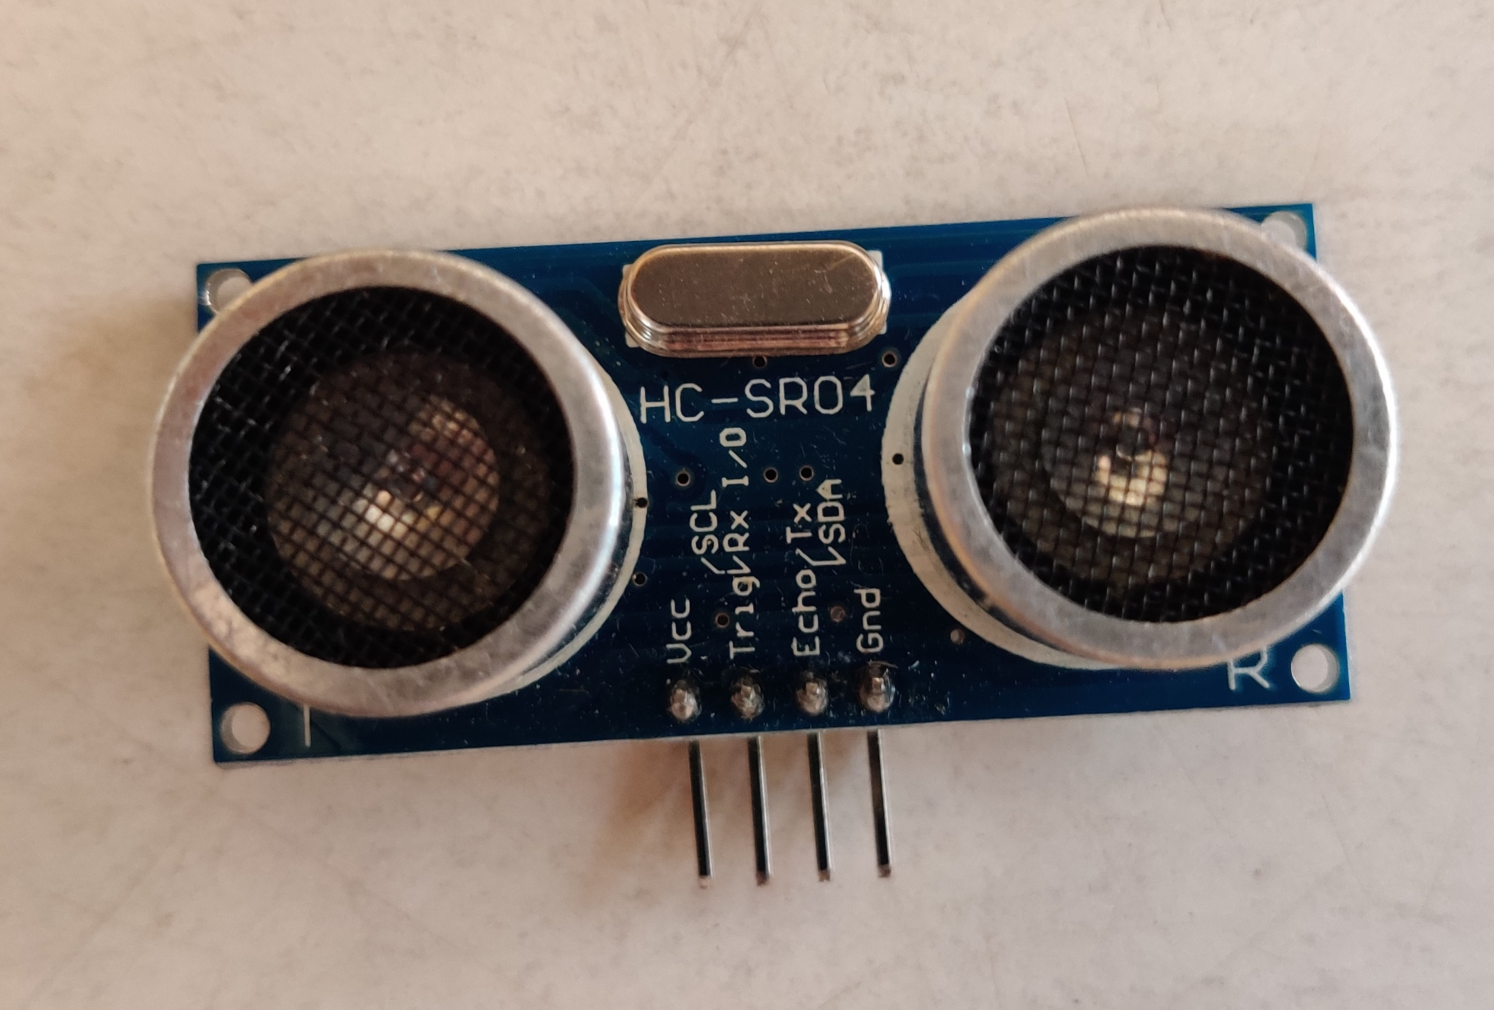
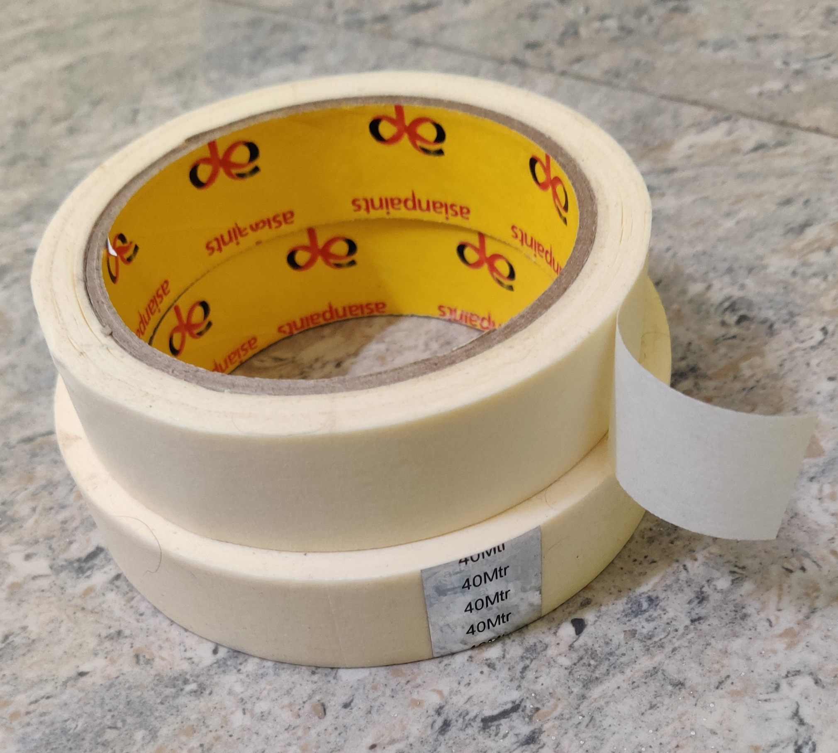
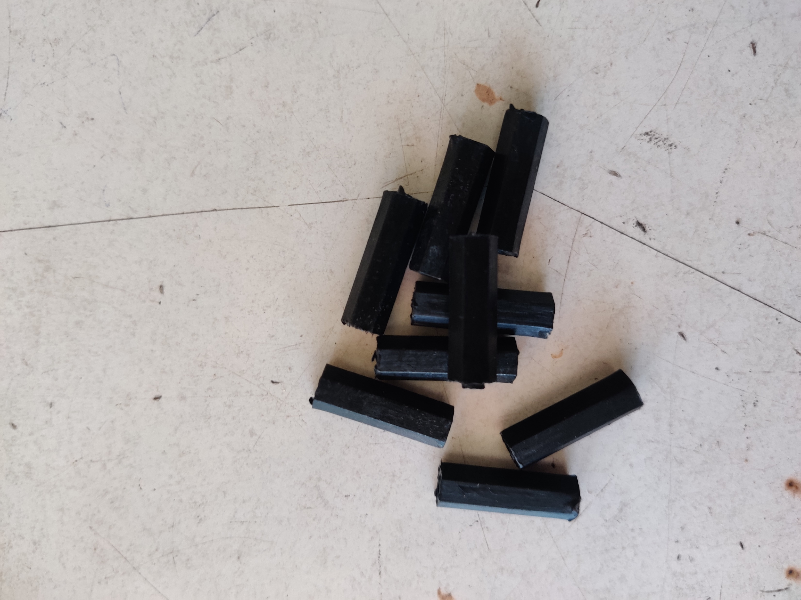
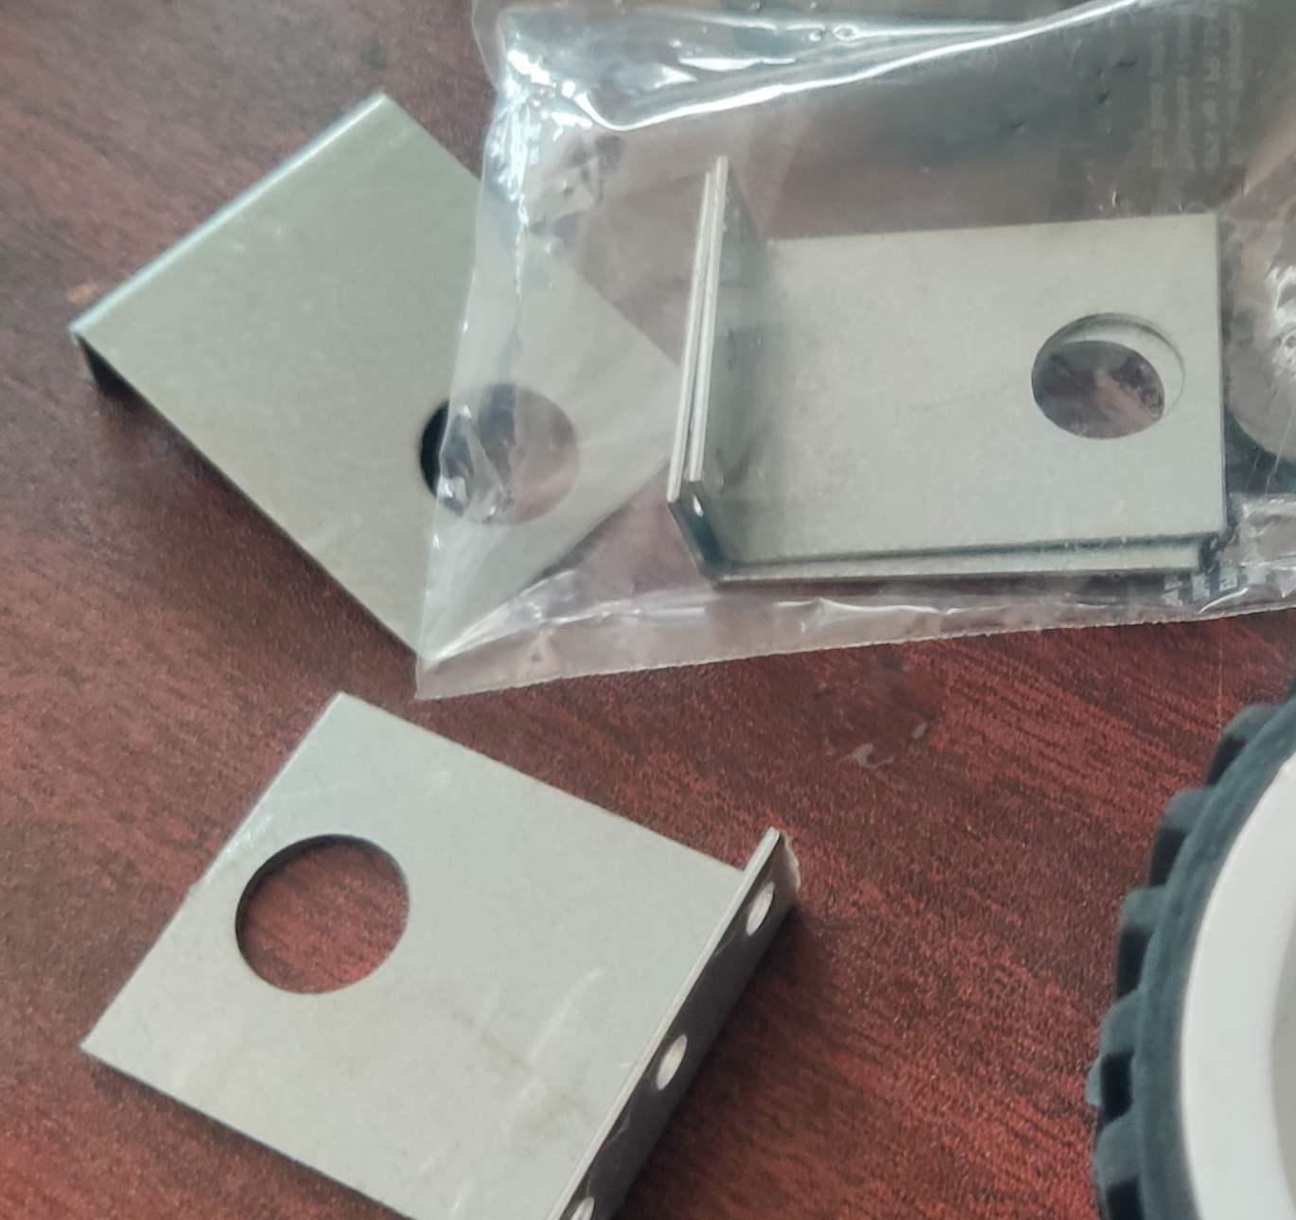
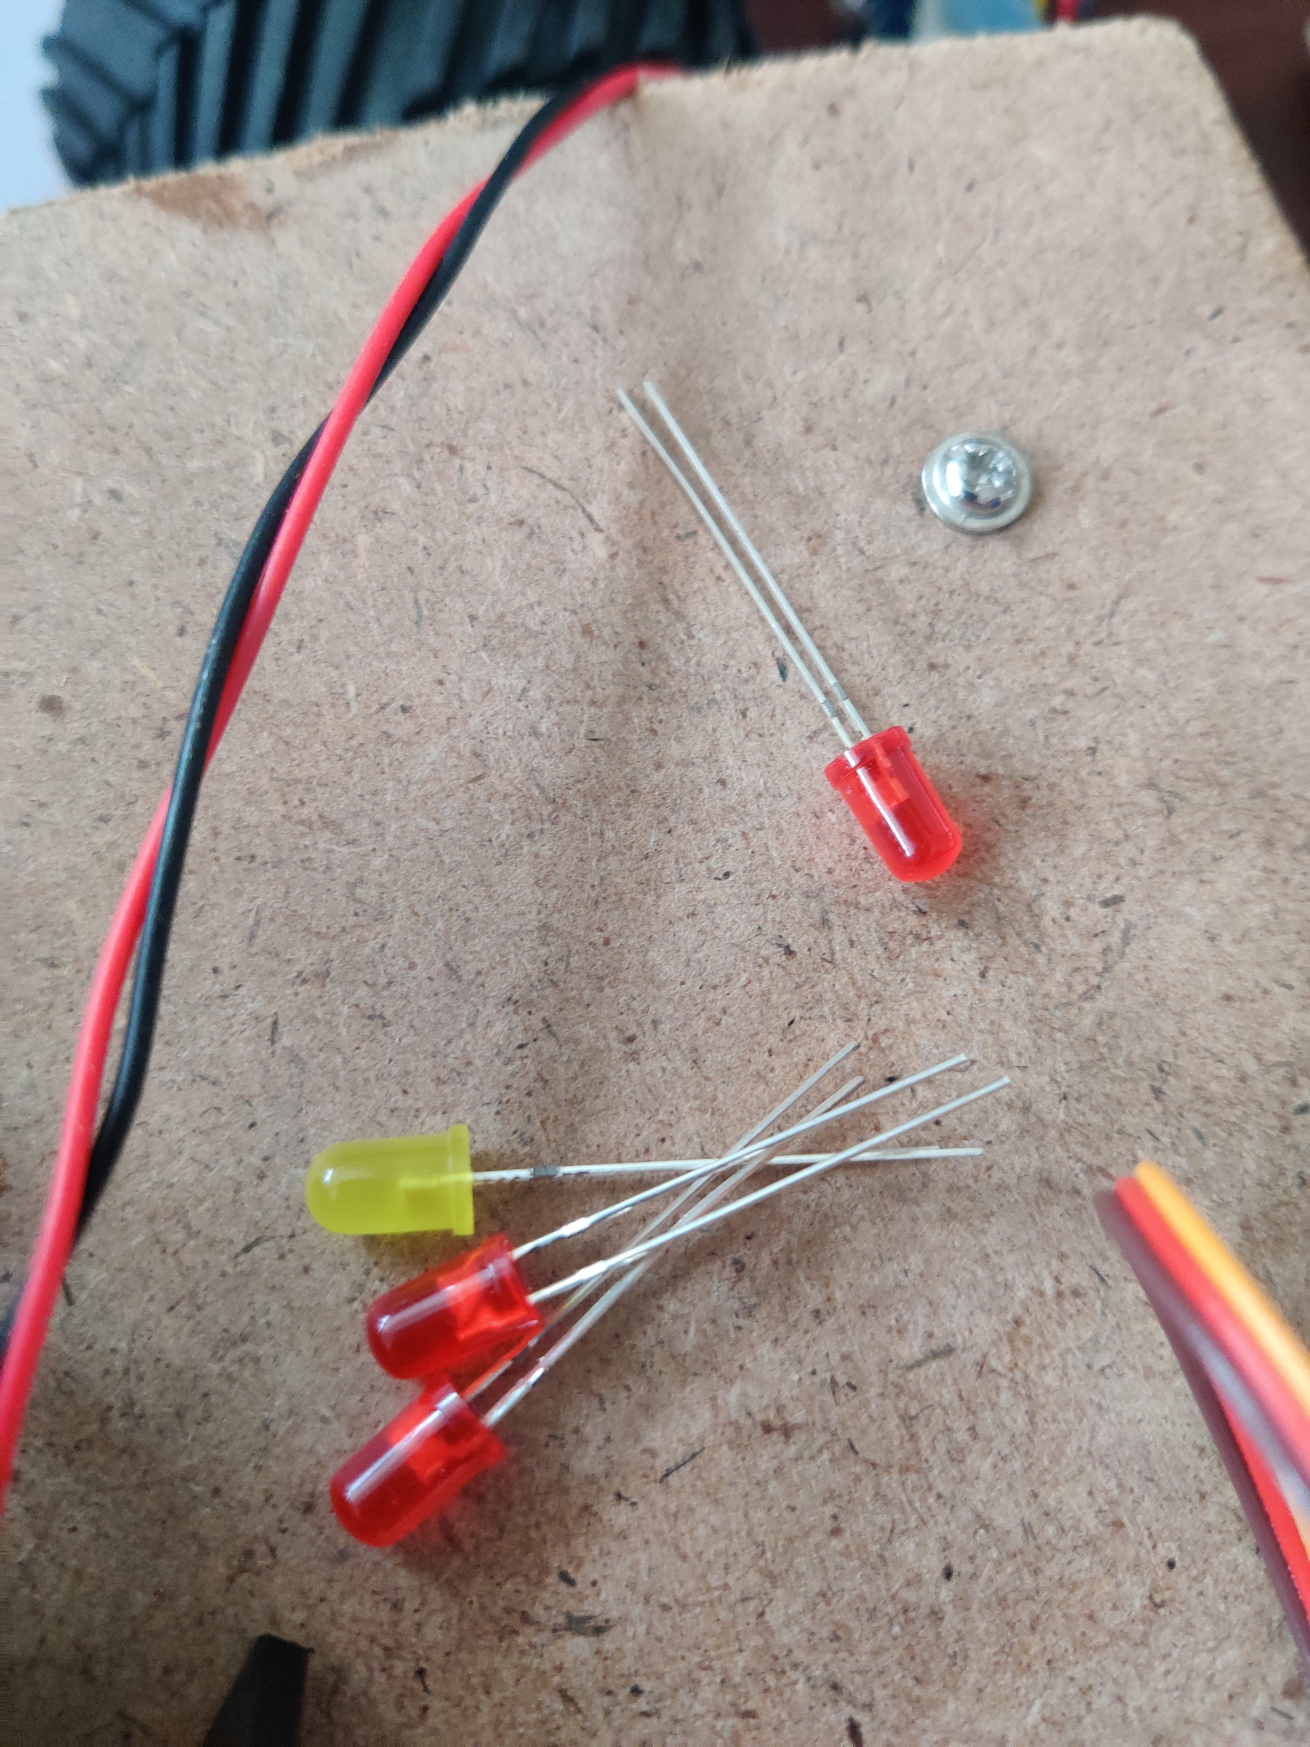
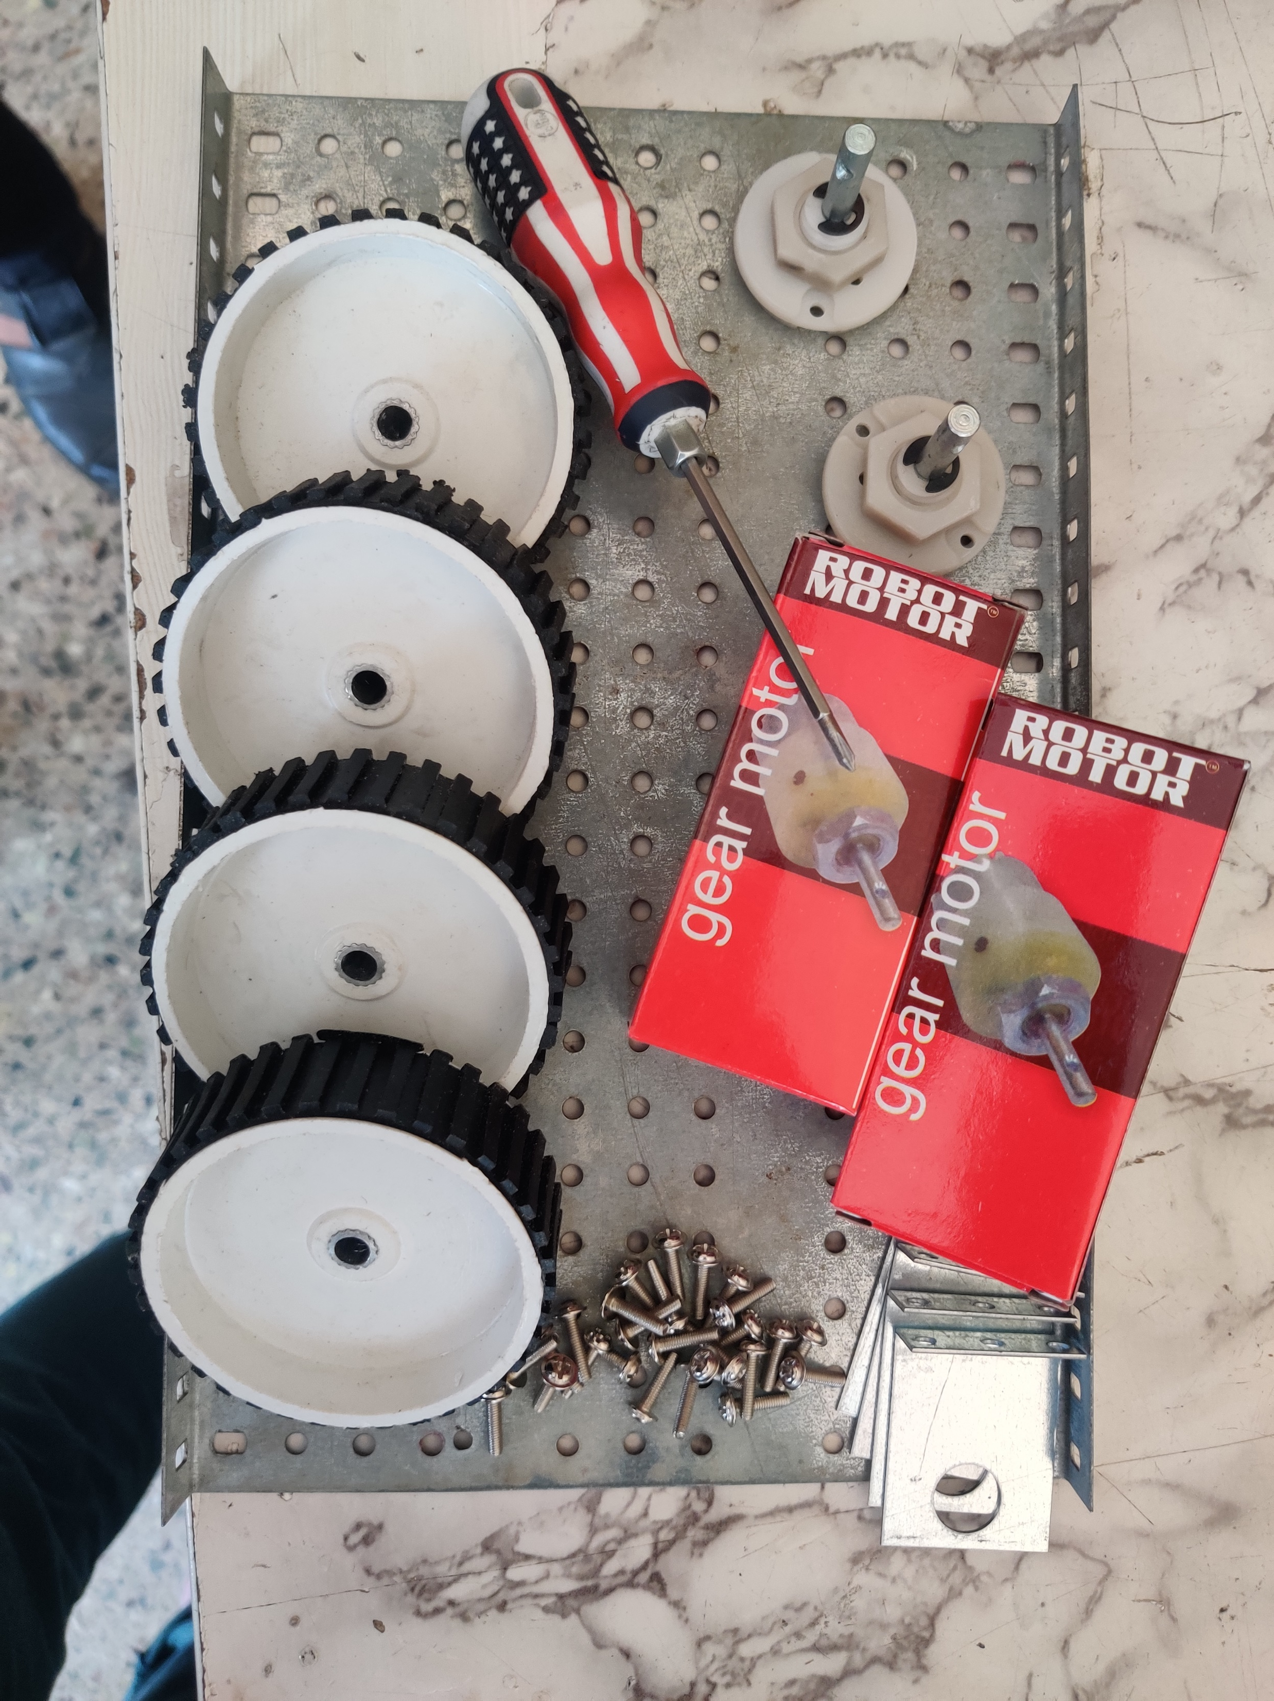
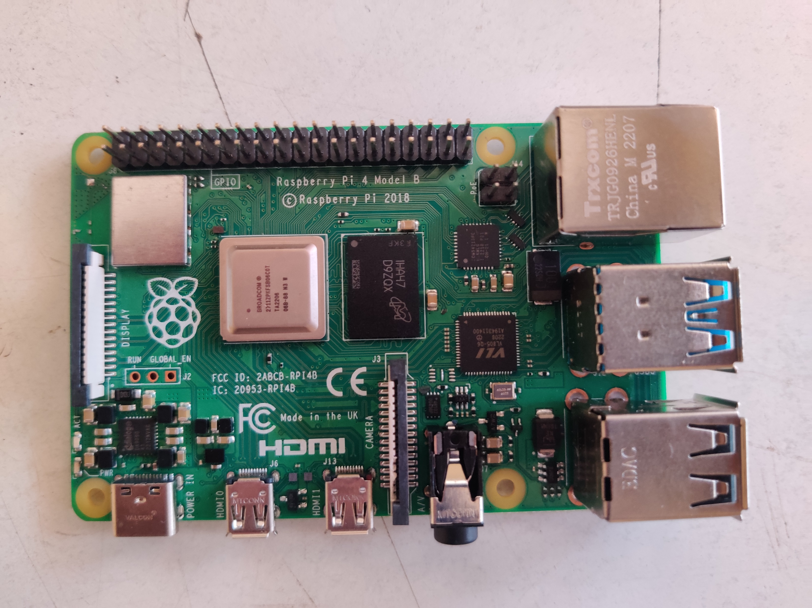
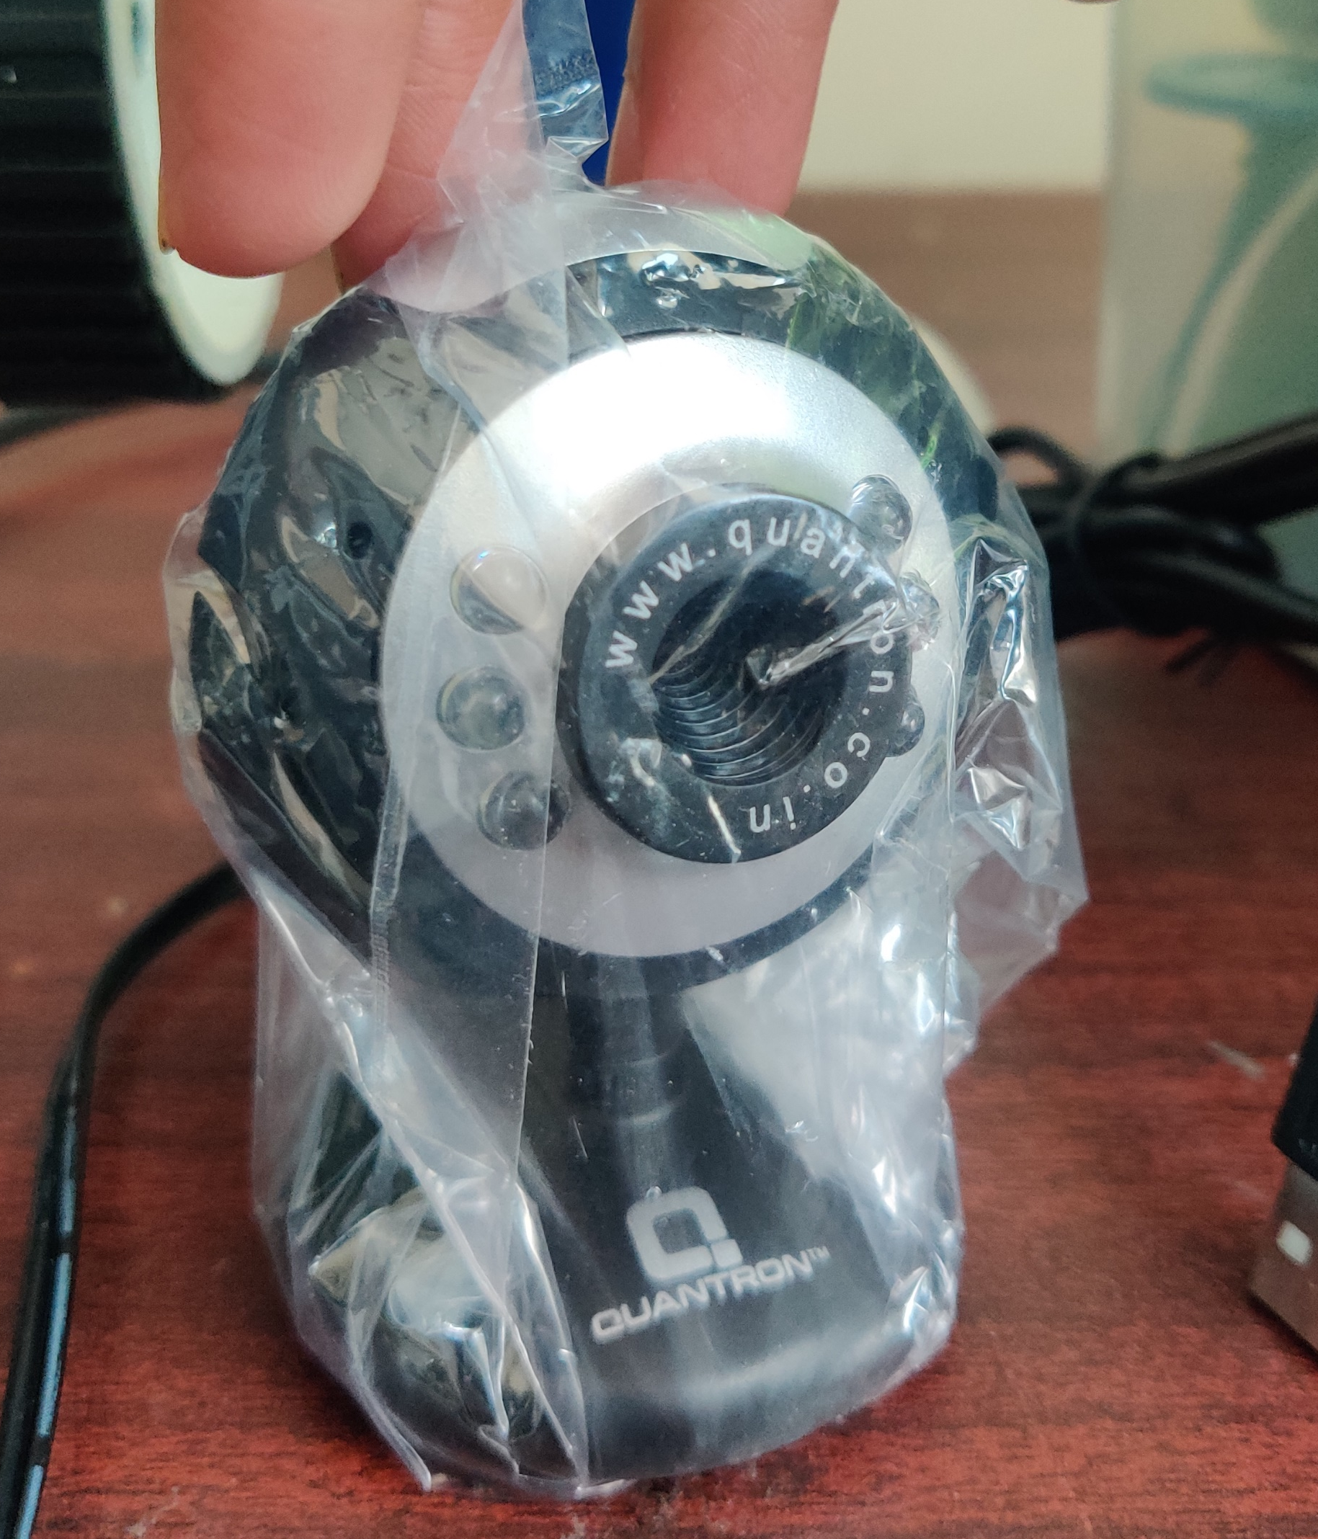
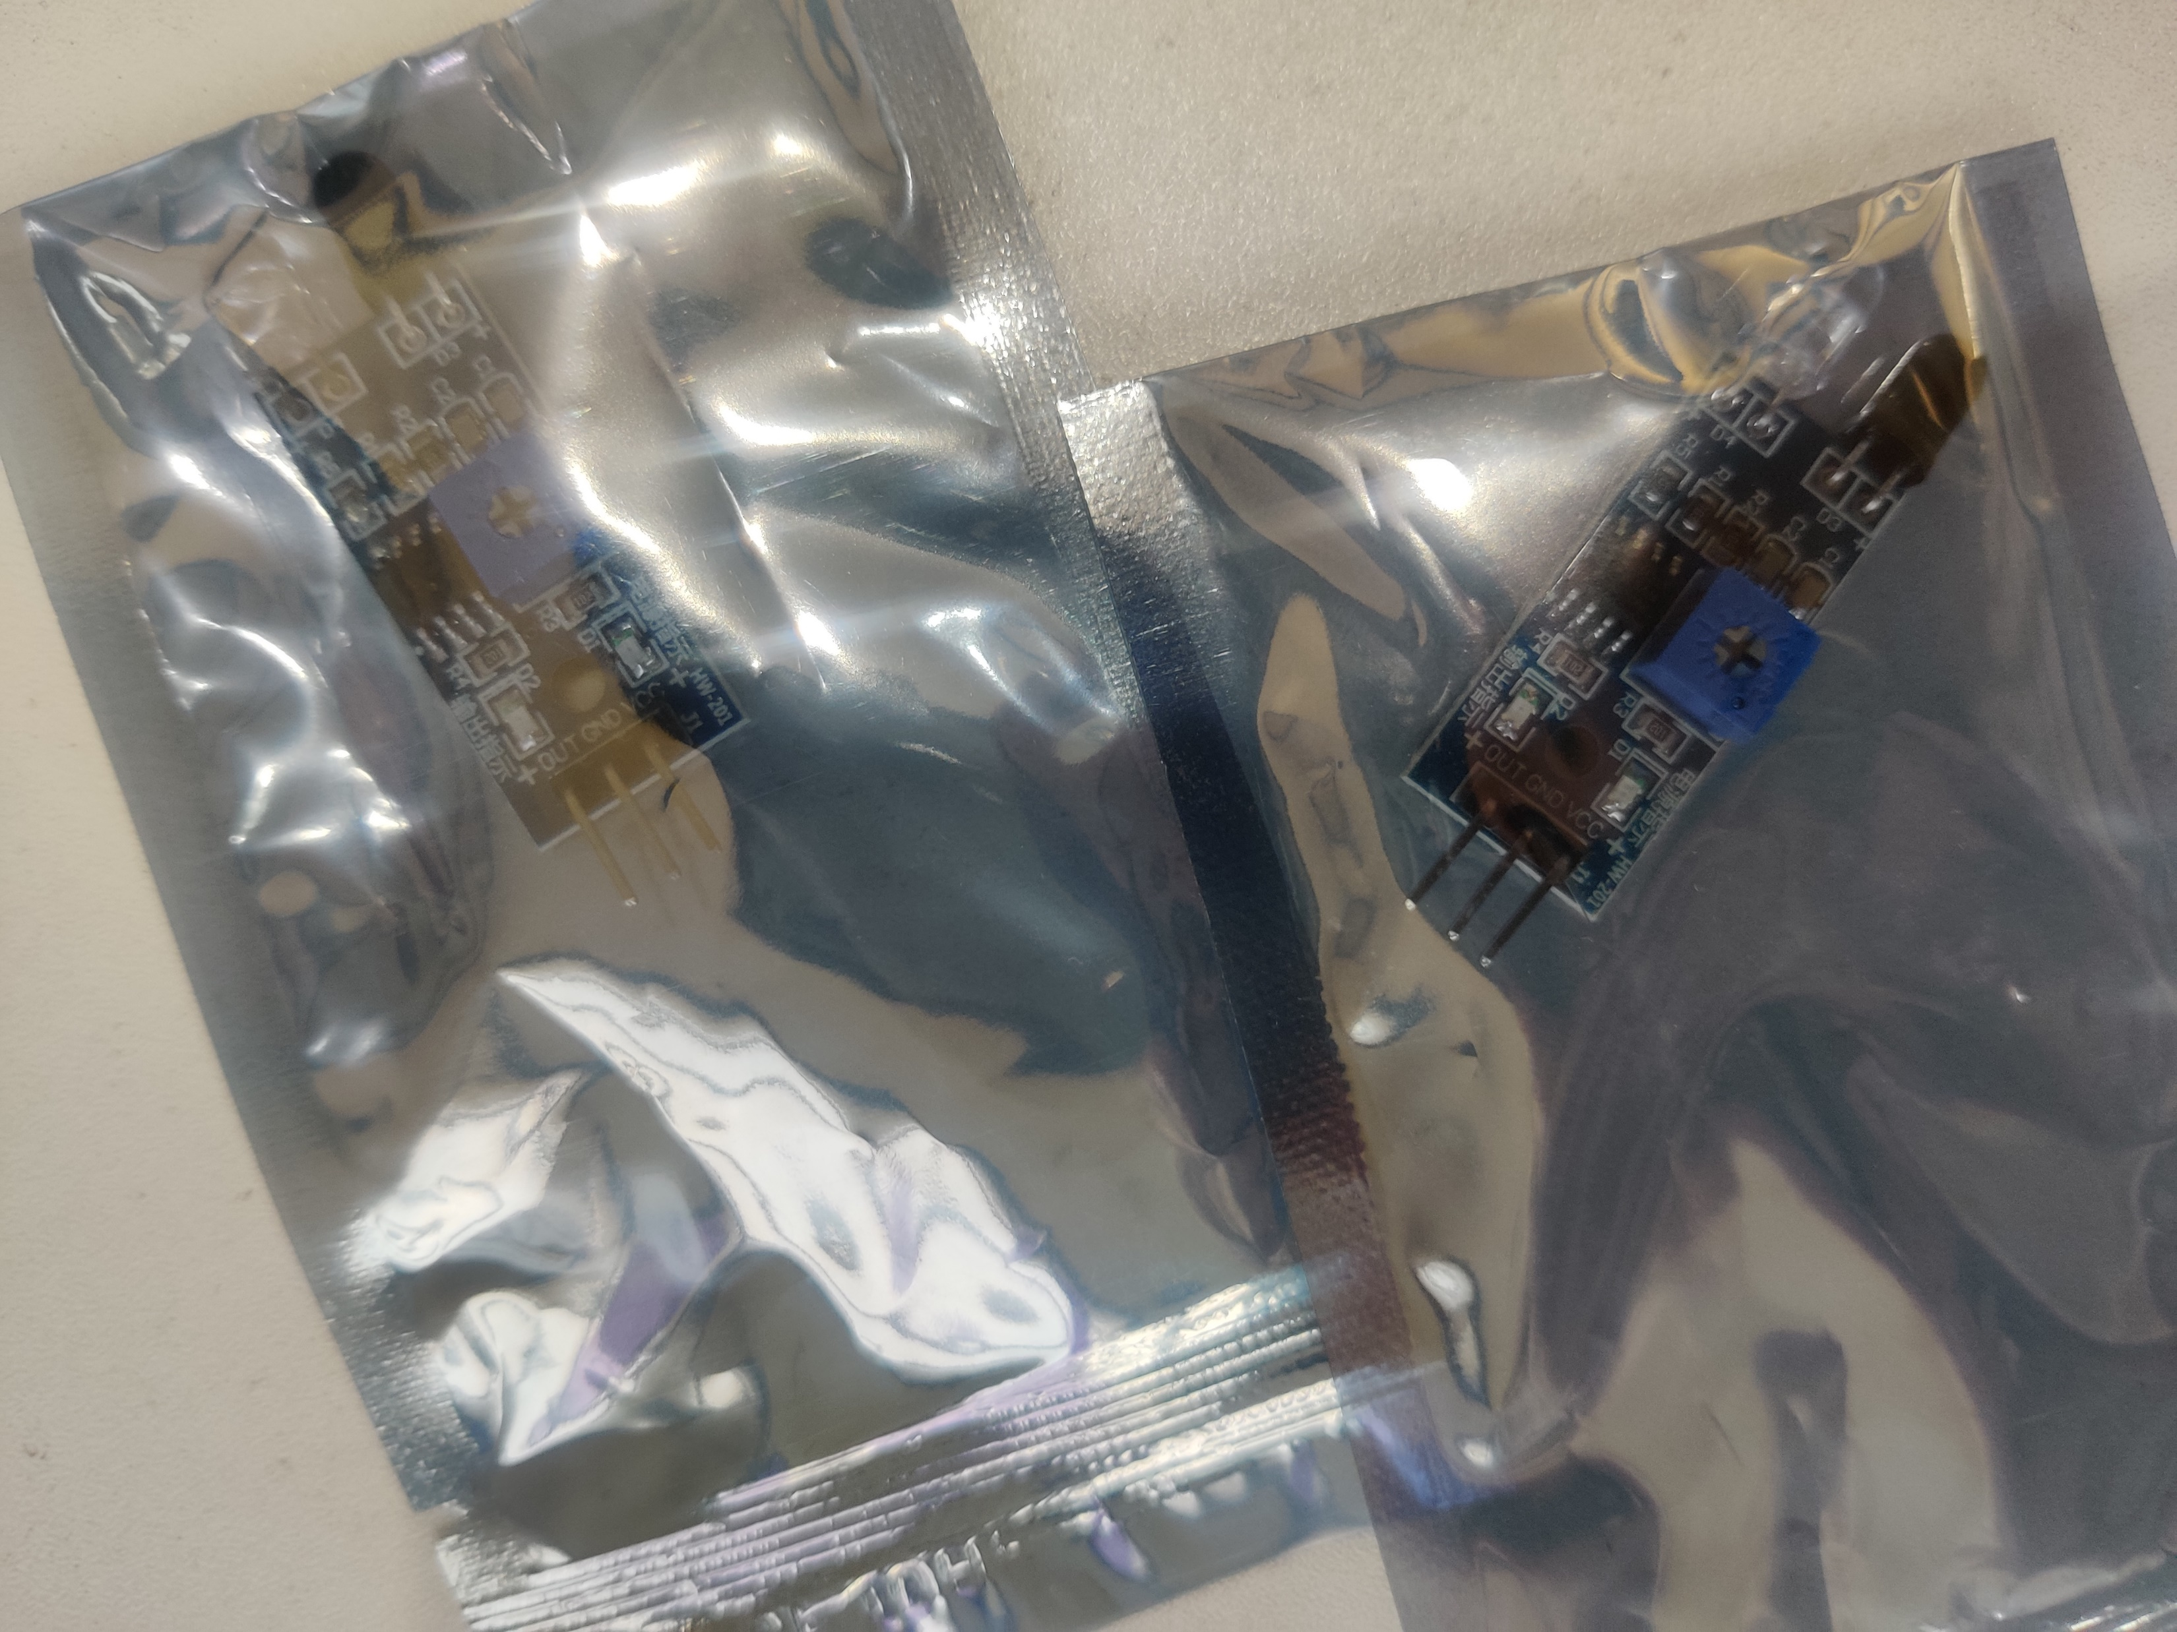
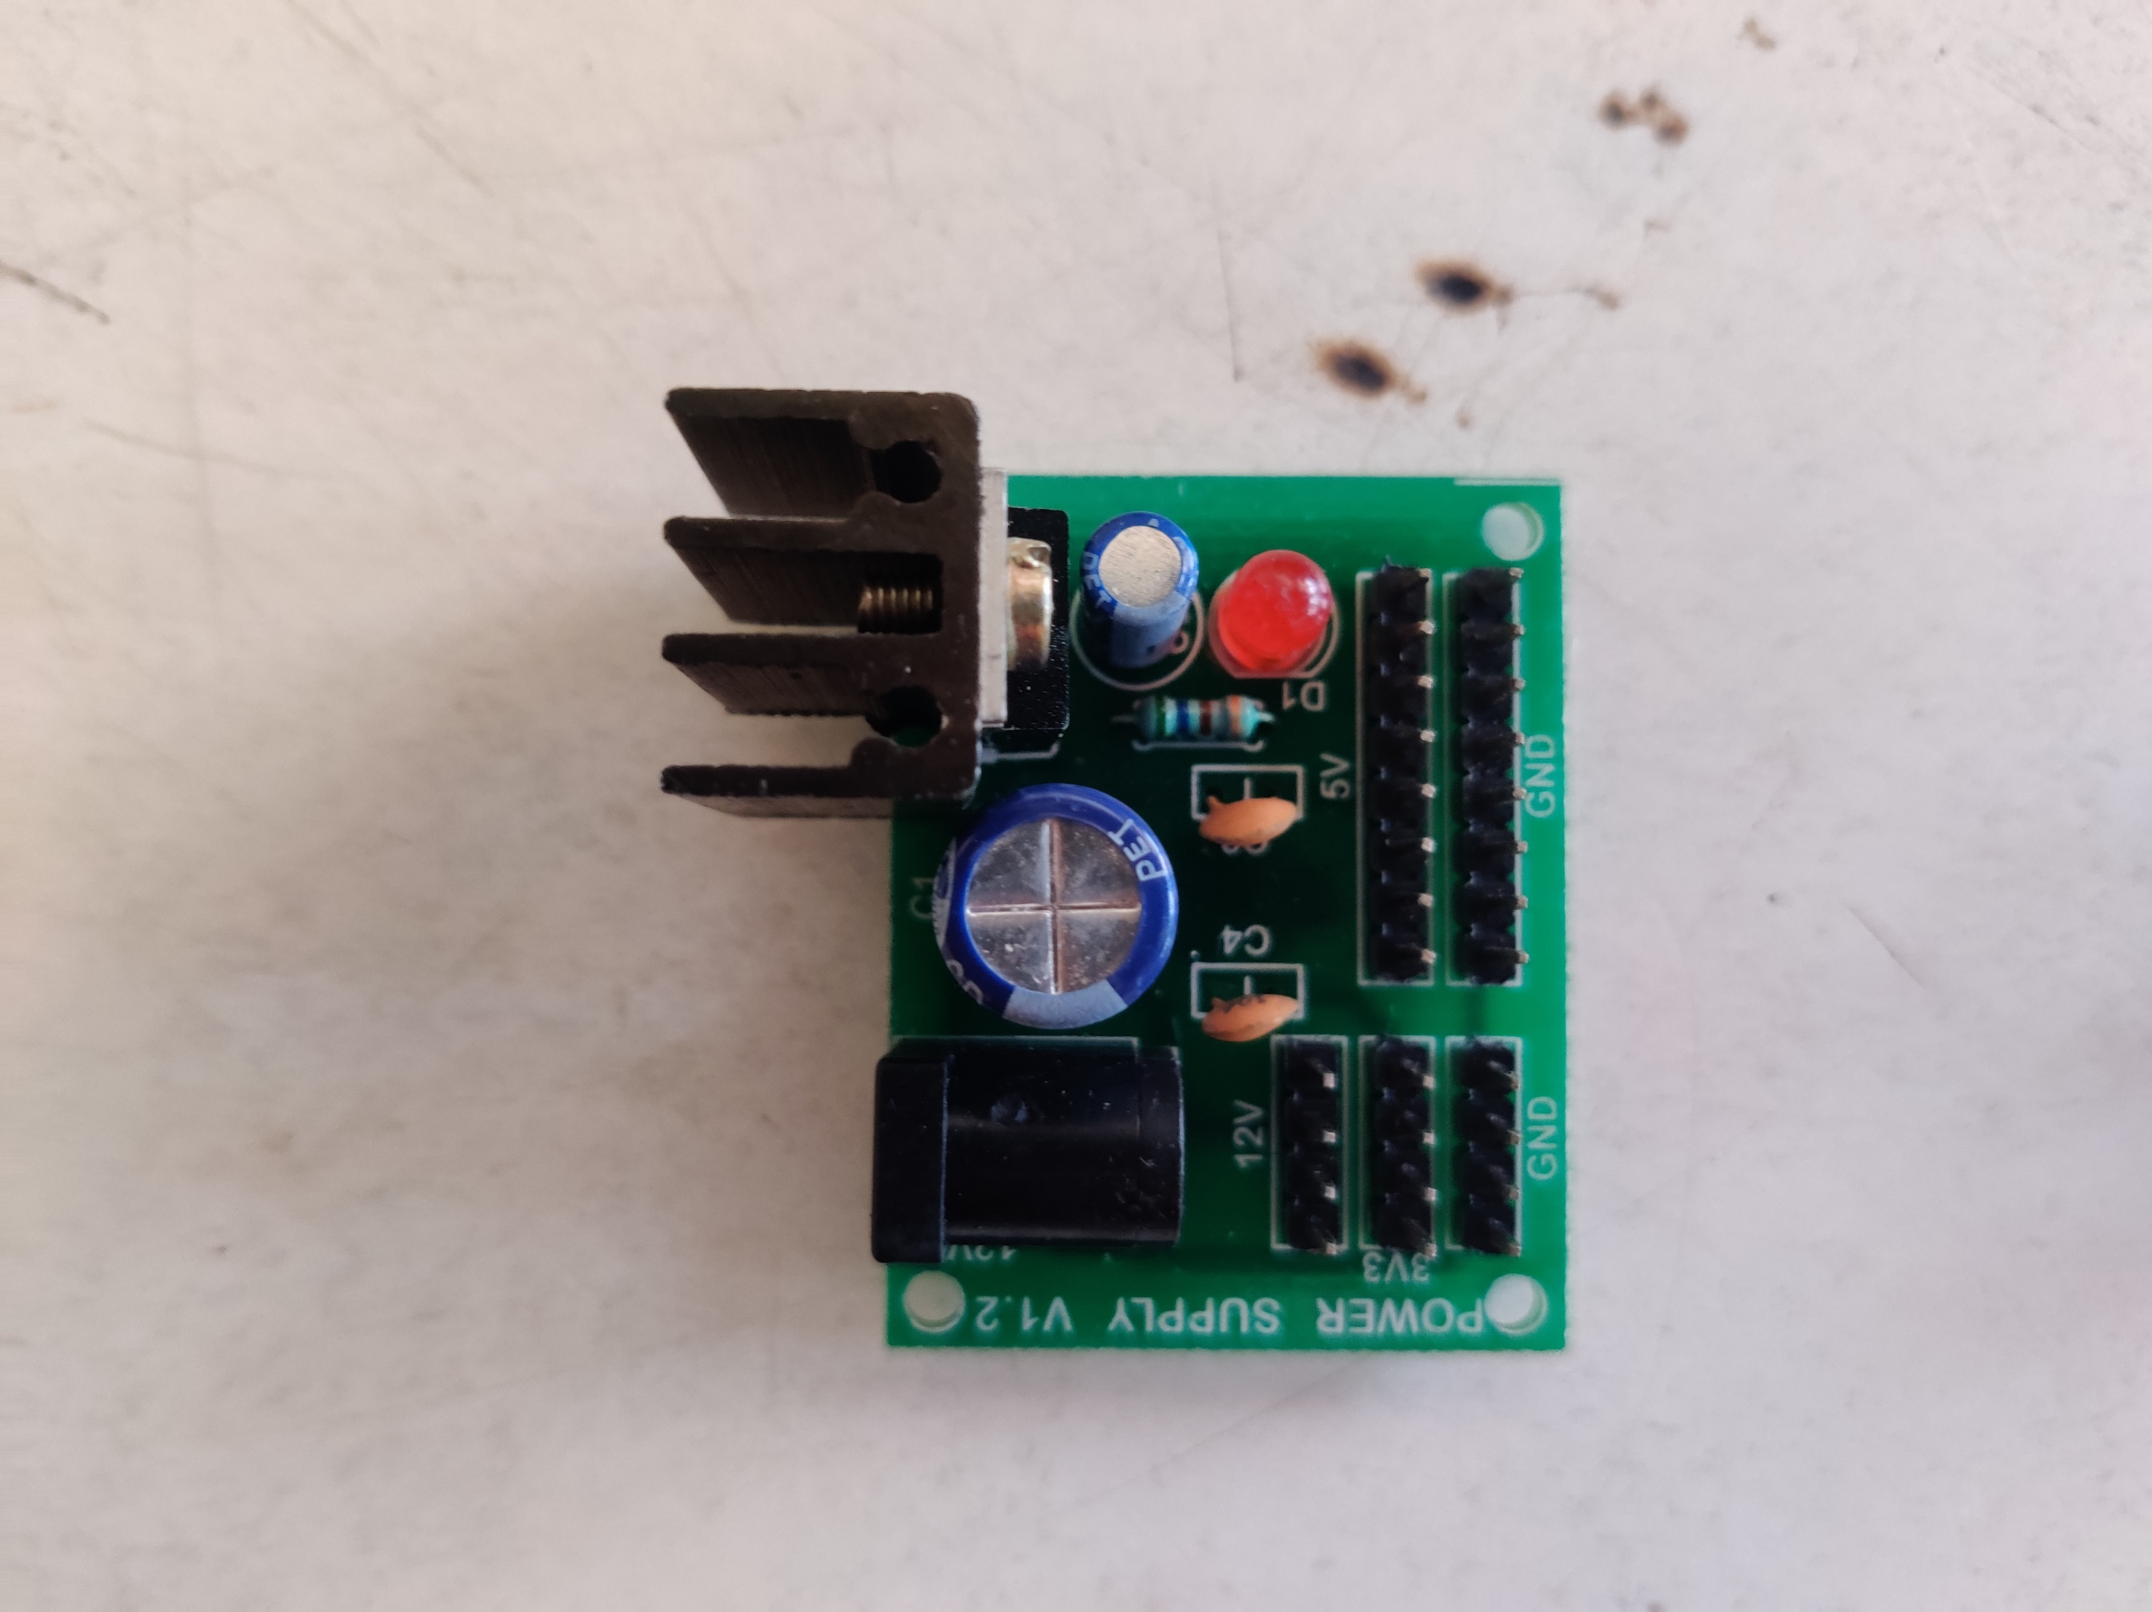
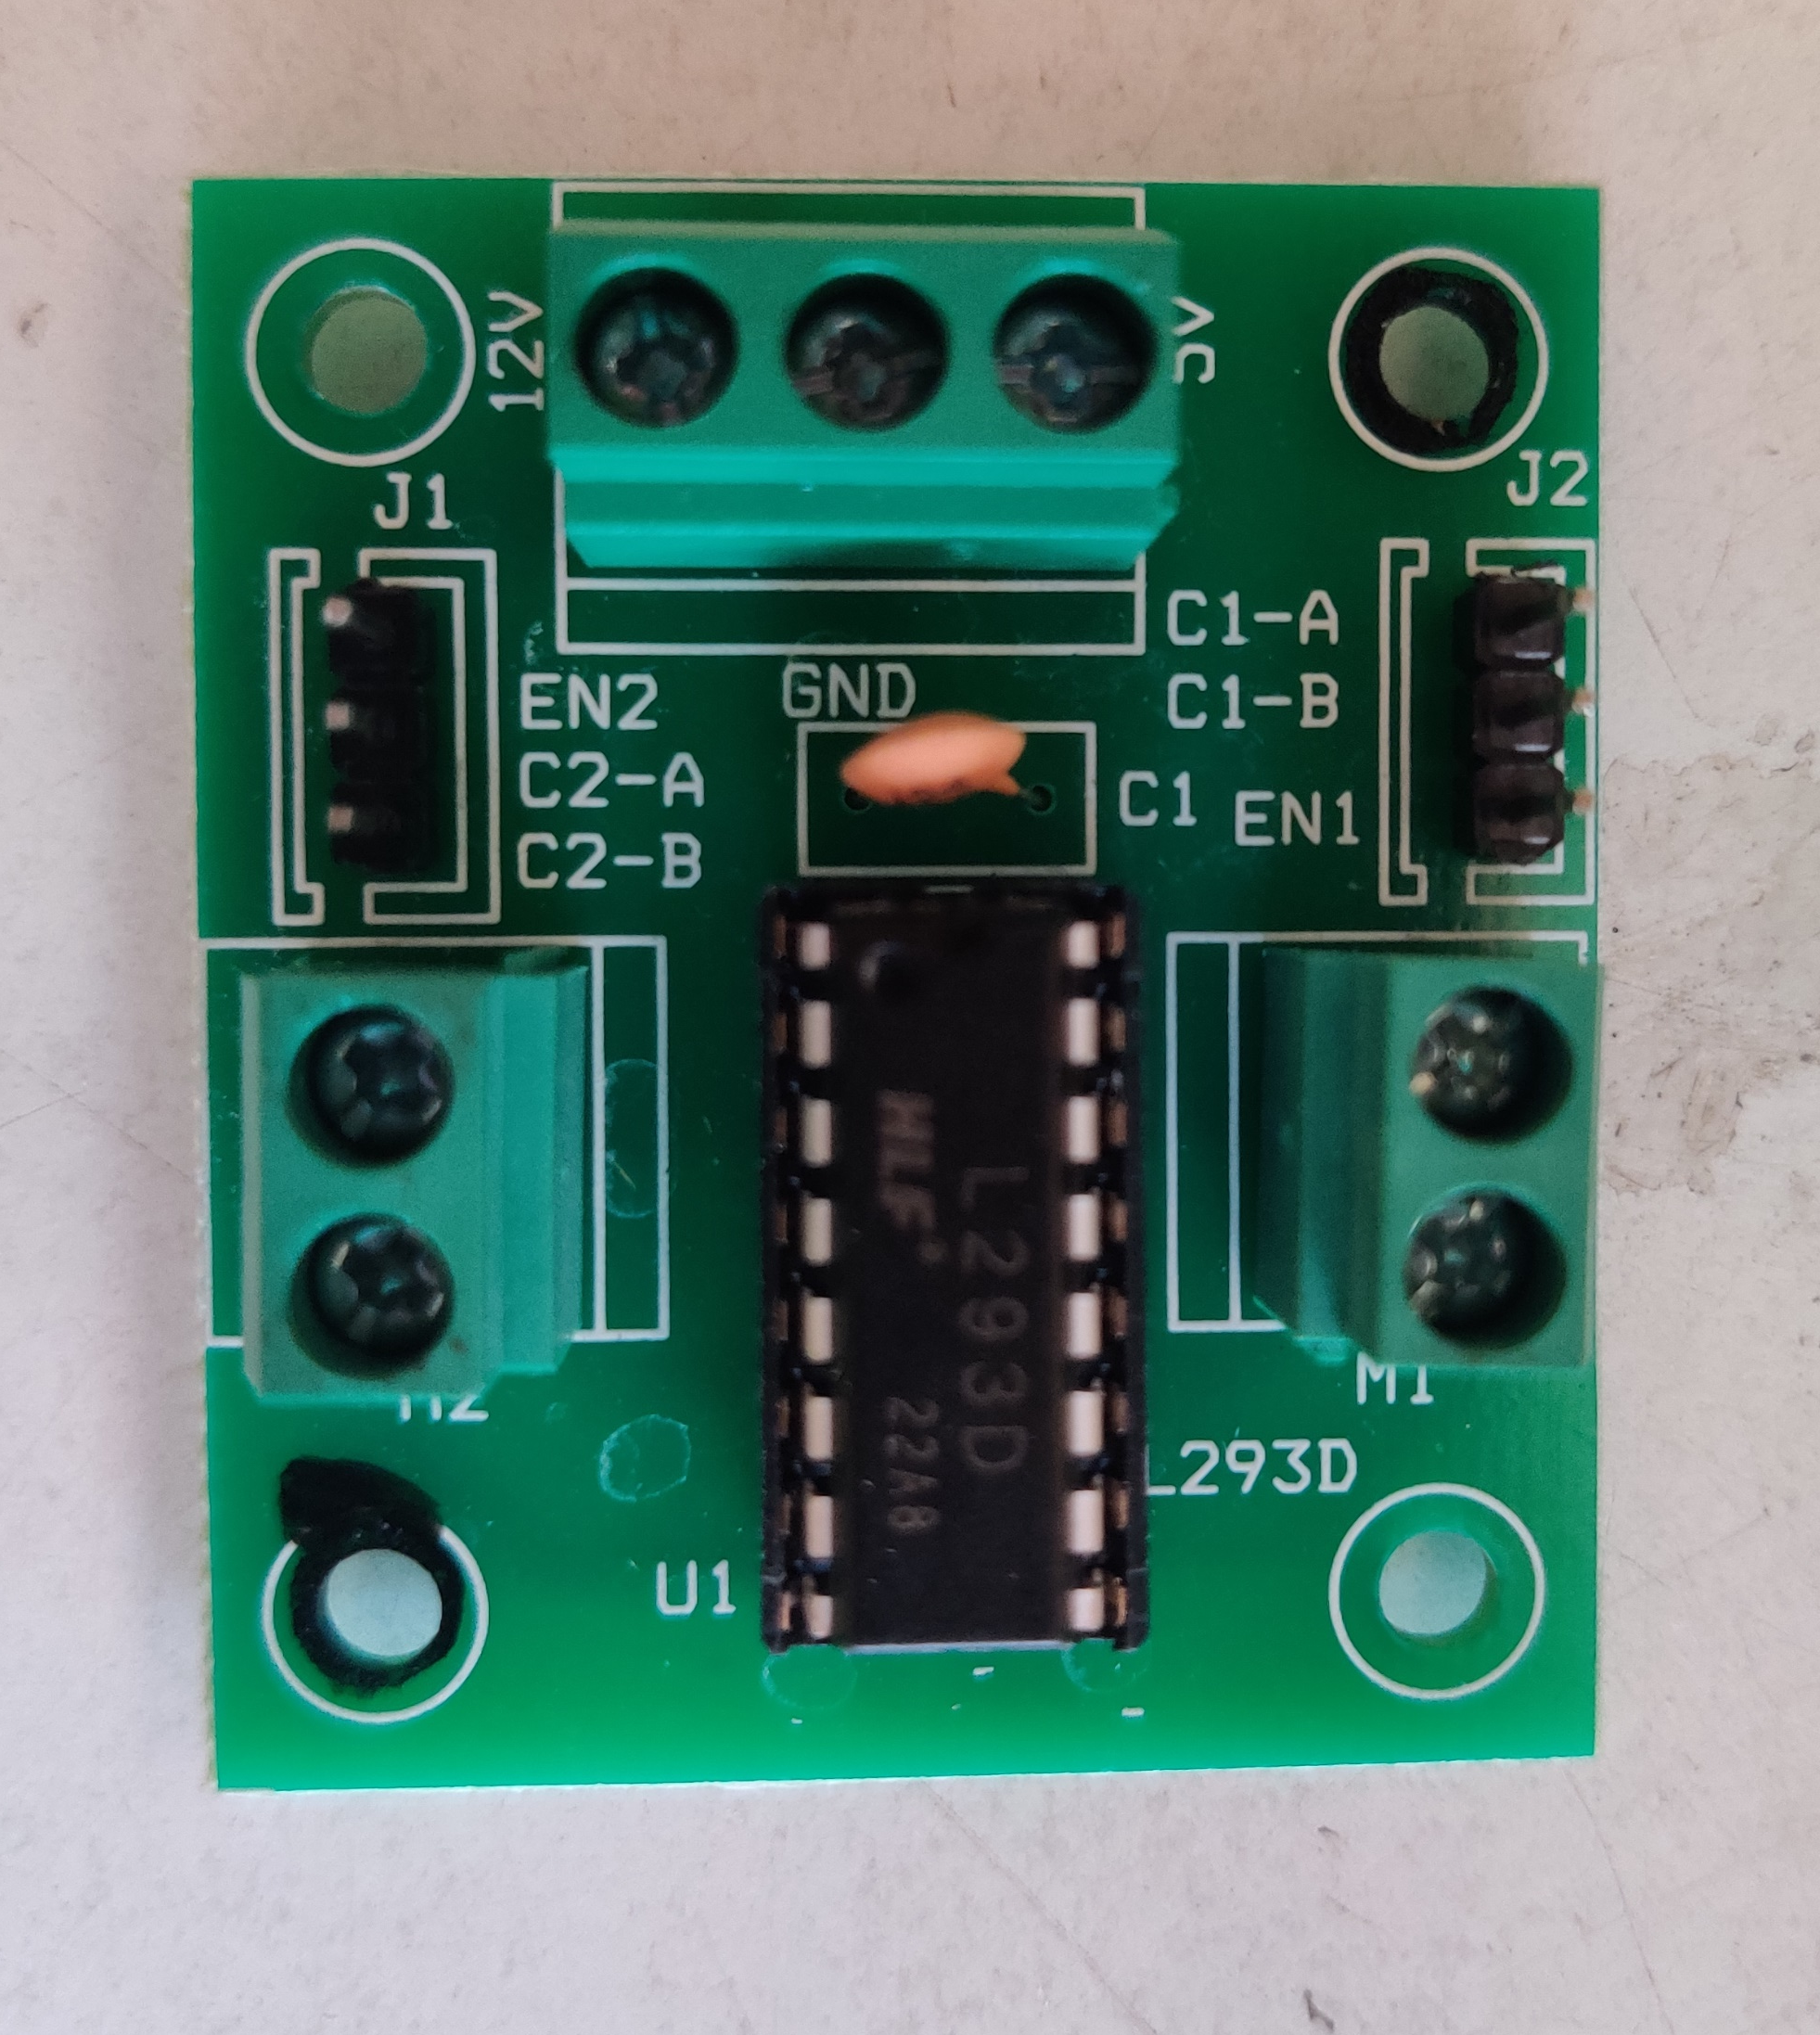
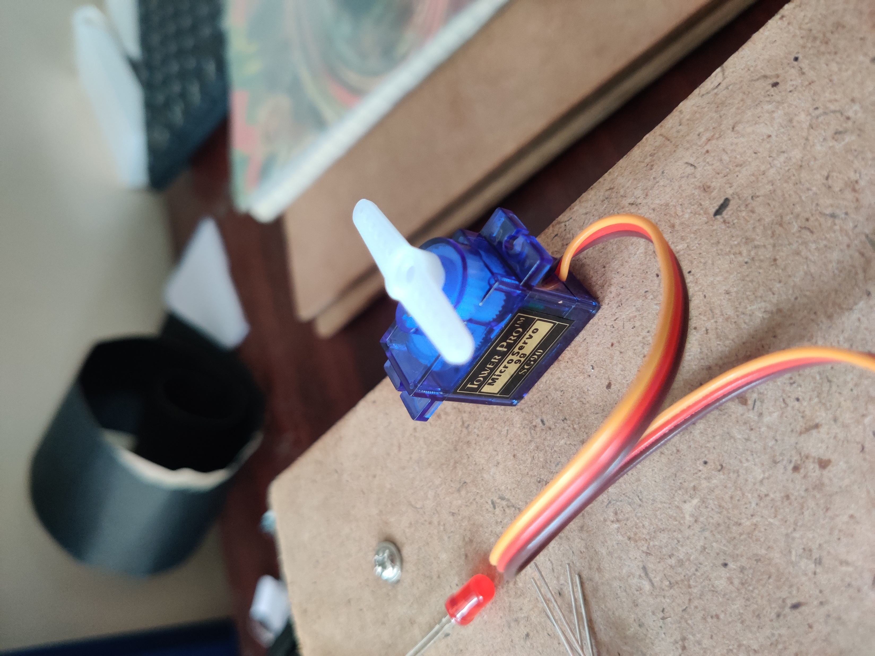
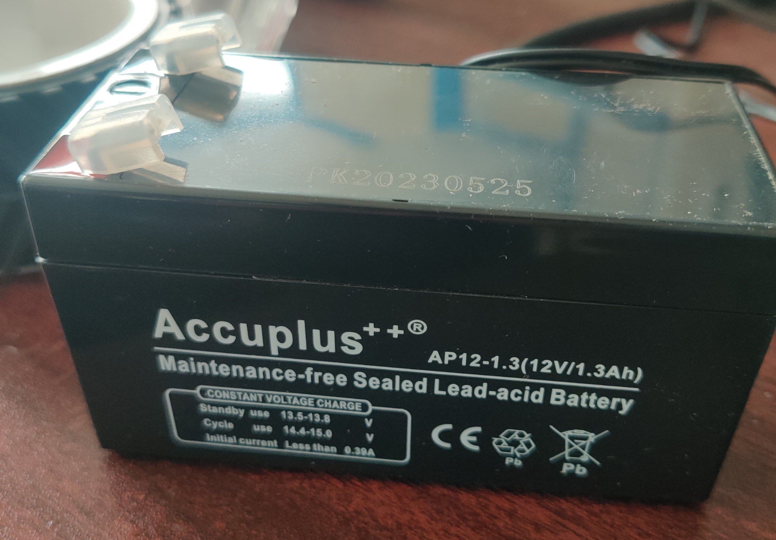
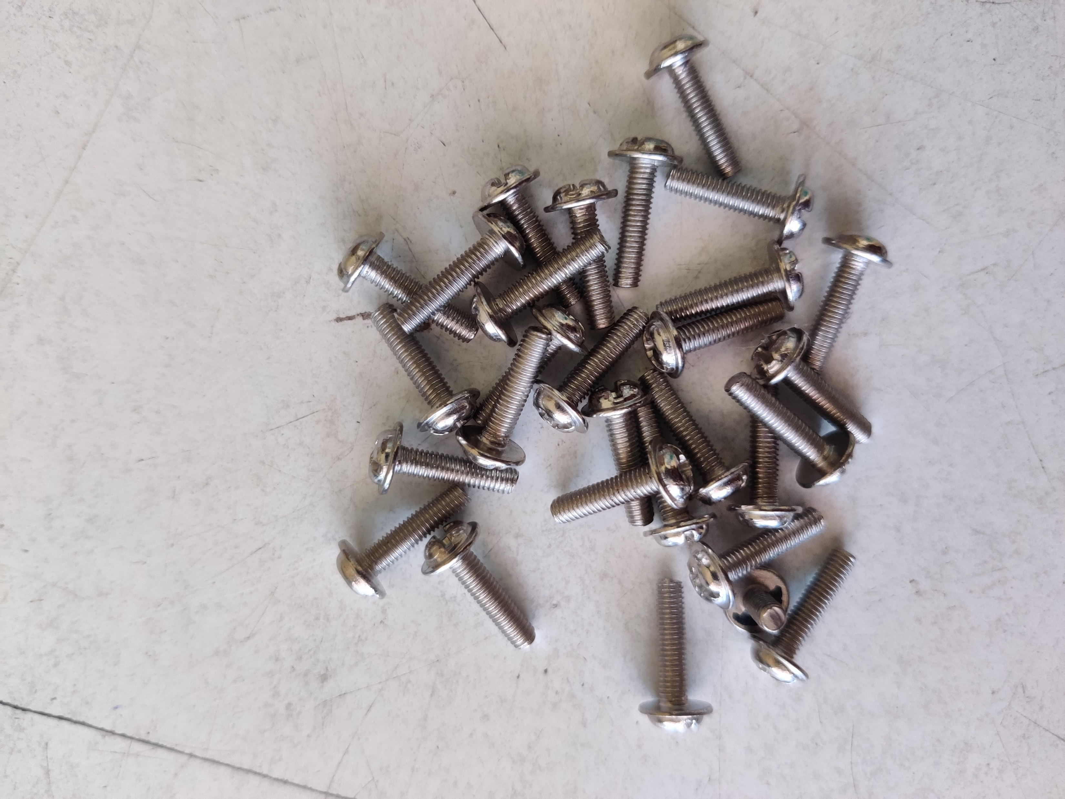
COMPONENTS

Slide 7
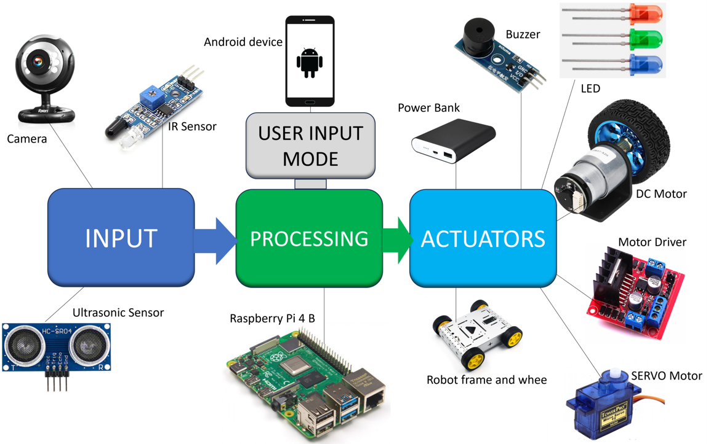
ARCHITECTURE

Slide 8
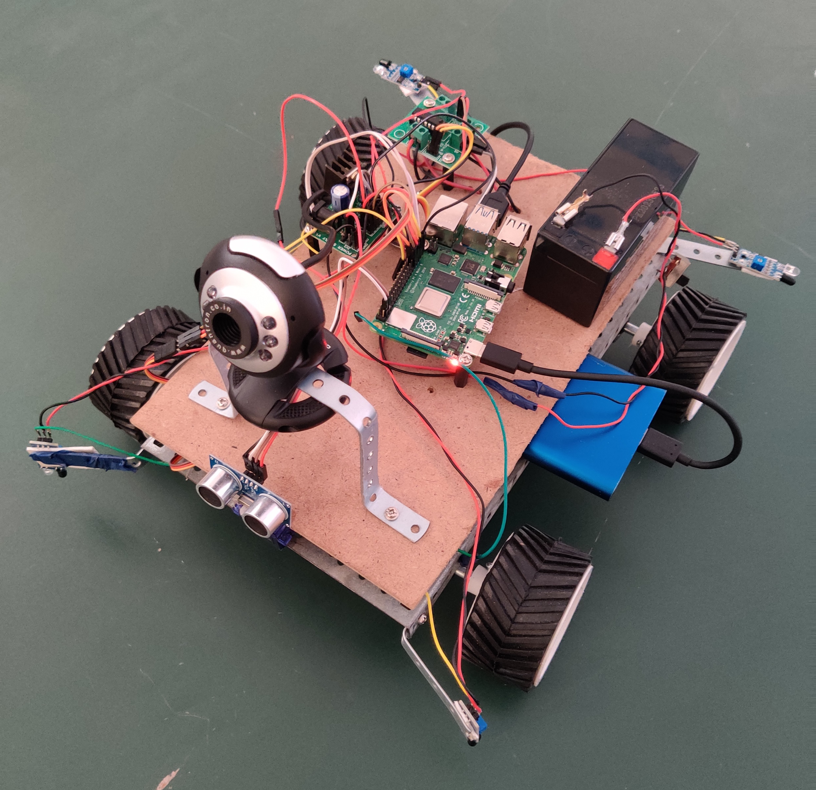
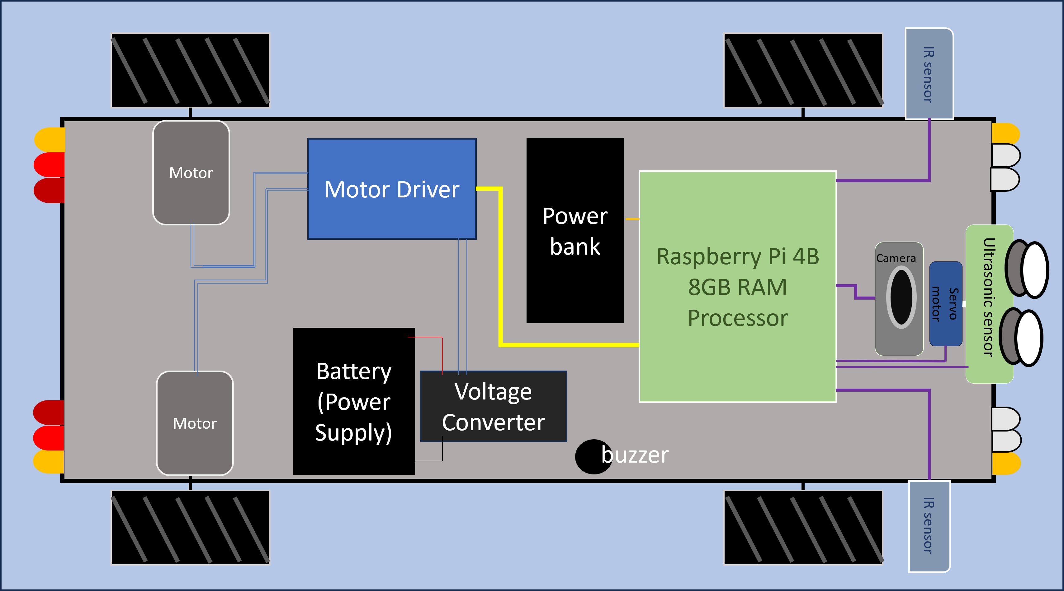
DESIGN ARCHITECTURE
IMPLEMENTED MODEL

Slide 9
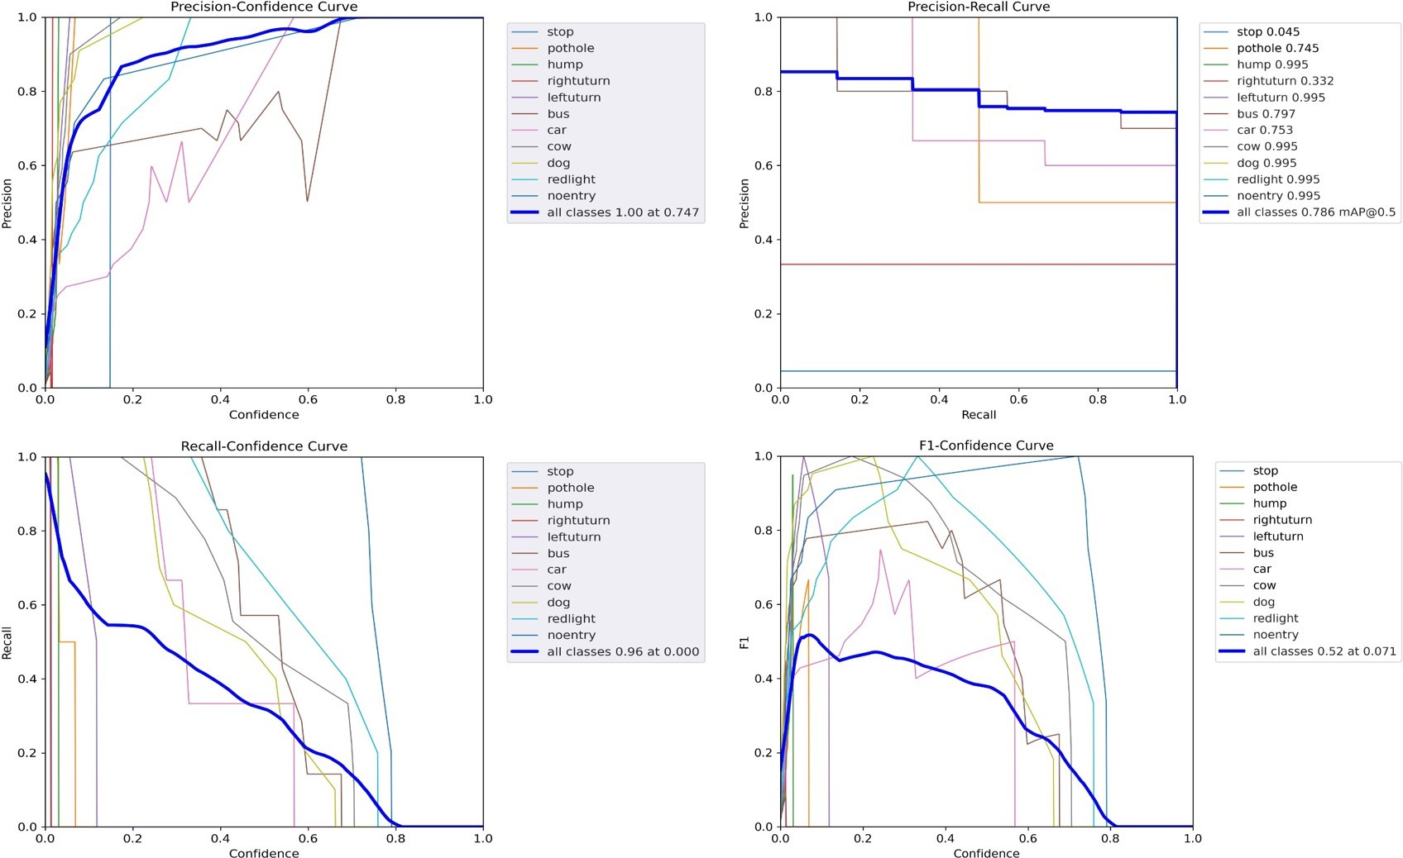
RESULT
Utilized YOLO version 5 algorithm for deep learning model training.
Achieved remarkable accuracy in object detection and classification.
Proficient in identifying vehicles, pedestrians, animals, and traffic signs.
Robust performance in recognizing and interpreting traffic signs and signals.
Deployed and tested on a 10-meter test track, simulating real-world driving conditions.
Demonstrated proficiency in lane detection, pathway identification, and obstacle avoidance.
Contributed to the creation of safer transportation environments.
Fig: Graph Analysis

Slide 10
CONCLUSION
In conclusion, our research, “Enhancing Transportation Safety with YOLO-based CNN Autonomous Vehicles”, introduces a pioneering methodology aimed at bolstering autonomous vehicle technologies. Quantitatively, our model achieved an impressive overall accuracy of 74-75 percent in real-time driving scenarios, demonstrating its effectiveness. Qualitatively, practical implementation on a 10-meter test track validated our system’s reliability and agility in maneuvering around obstacles. The seamless integration of sensors and components further enhances our vehicle’s performance. Our strategic roadmap ensures smooth integration into existing transportation networks, promising safer and more efficient mobility.

Slide 11
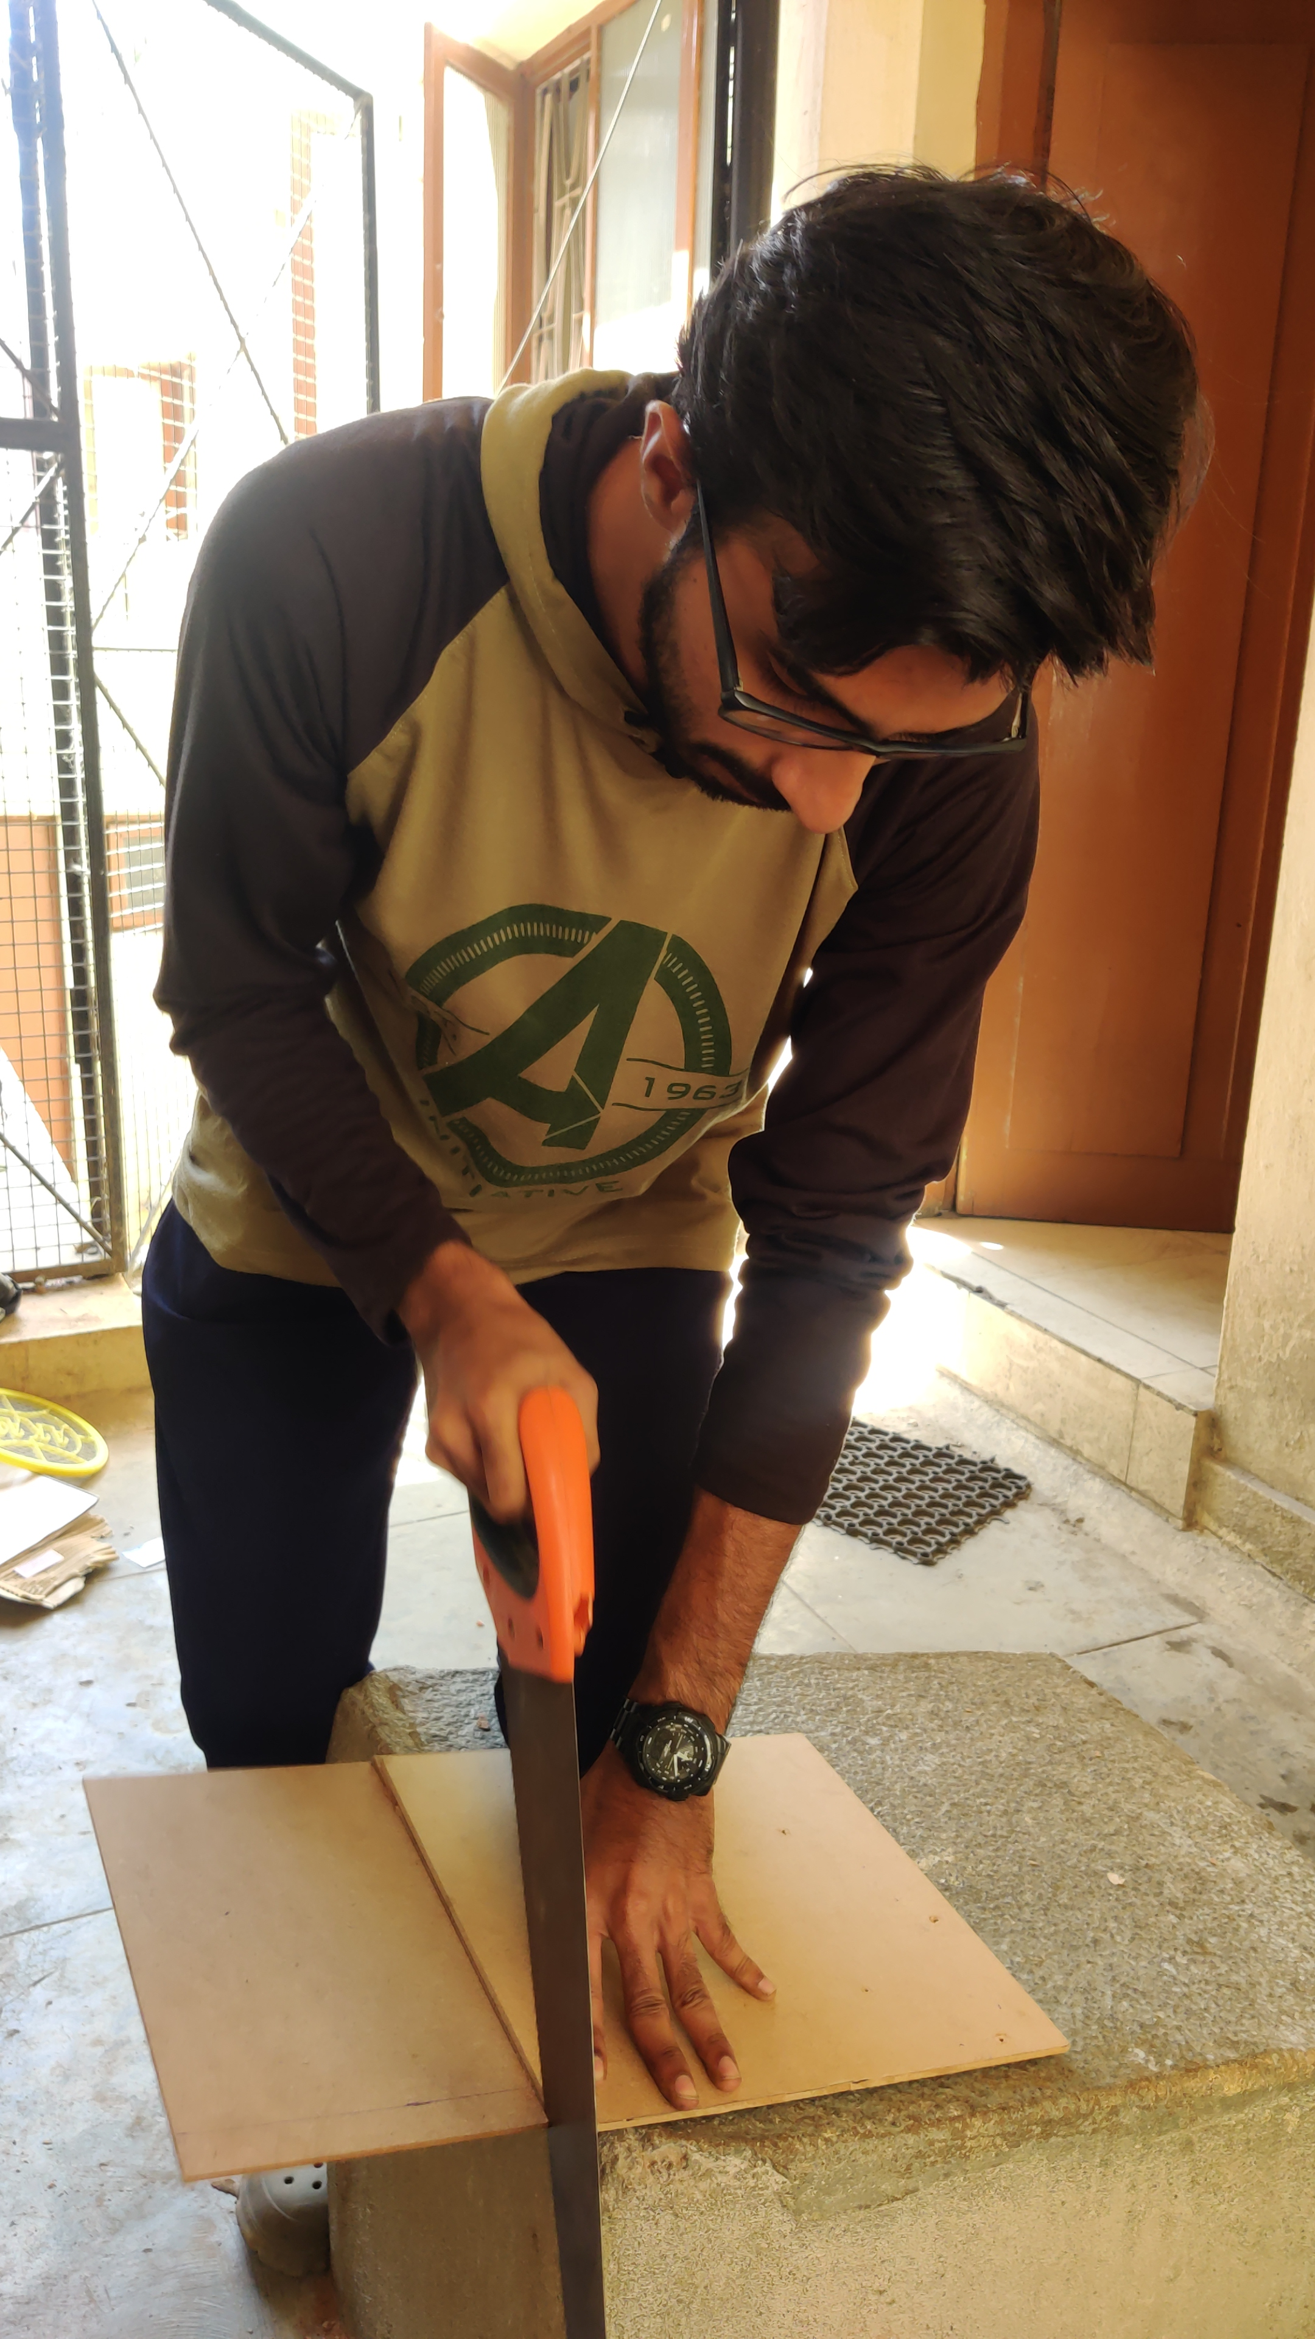
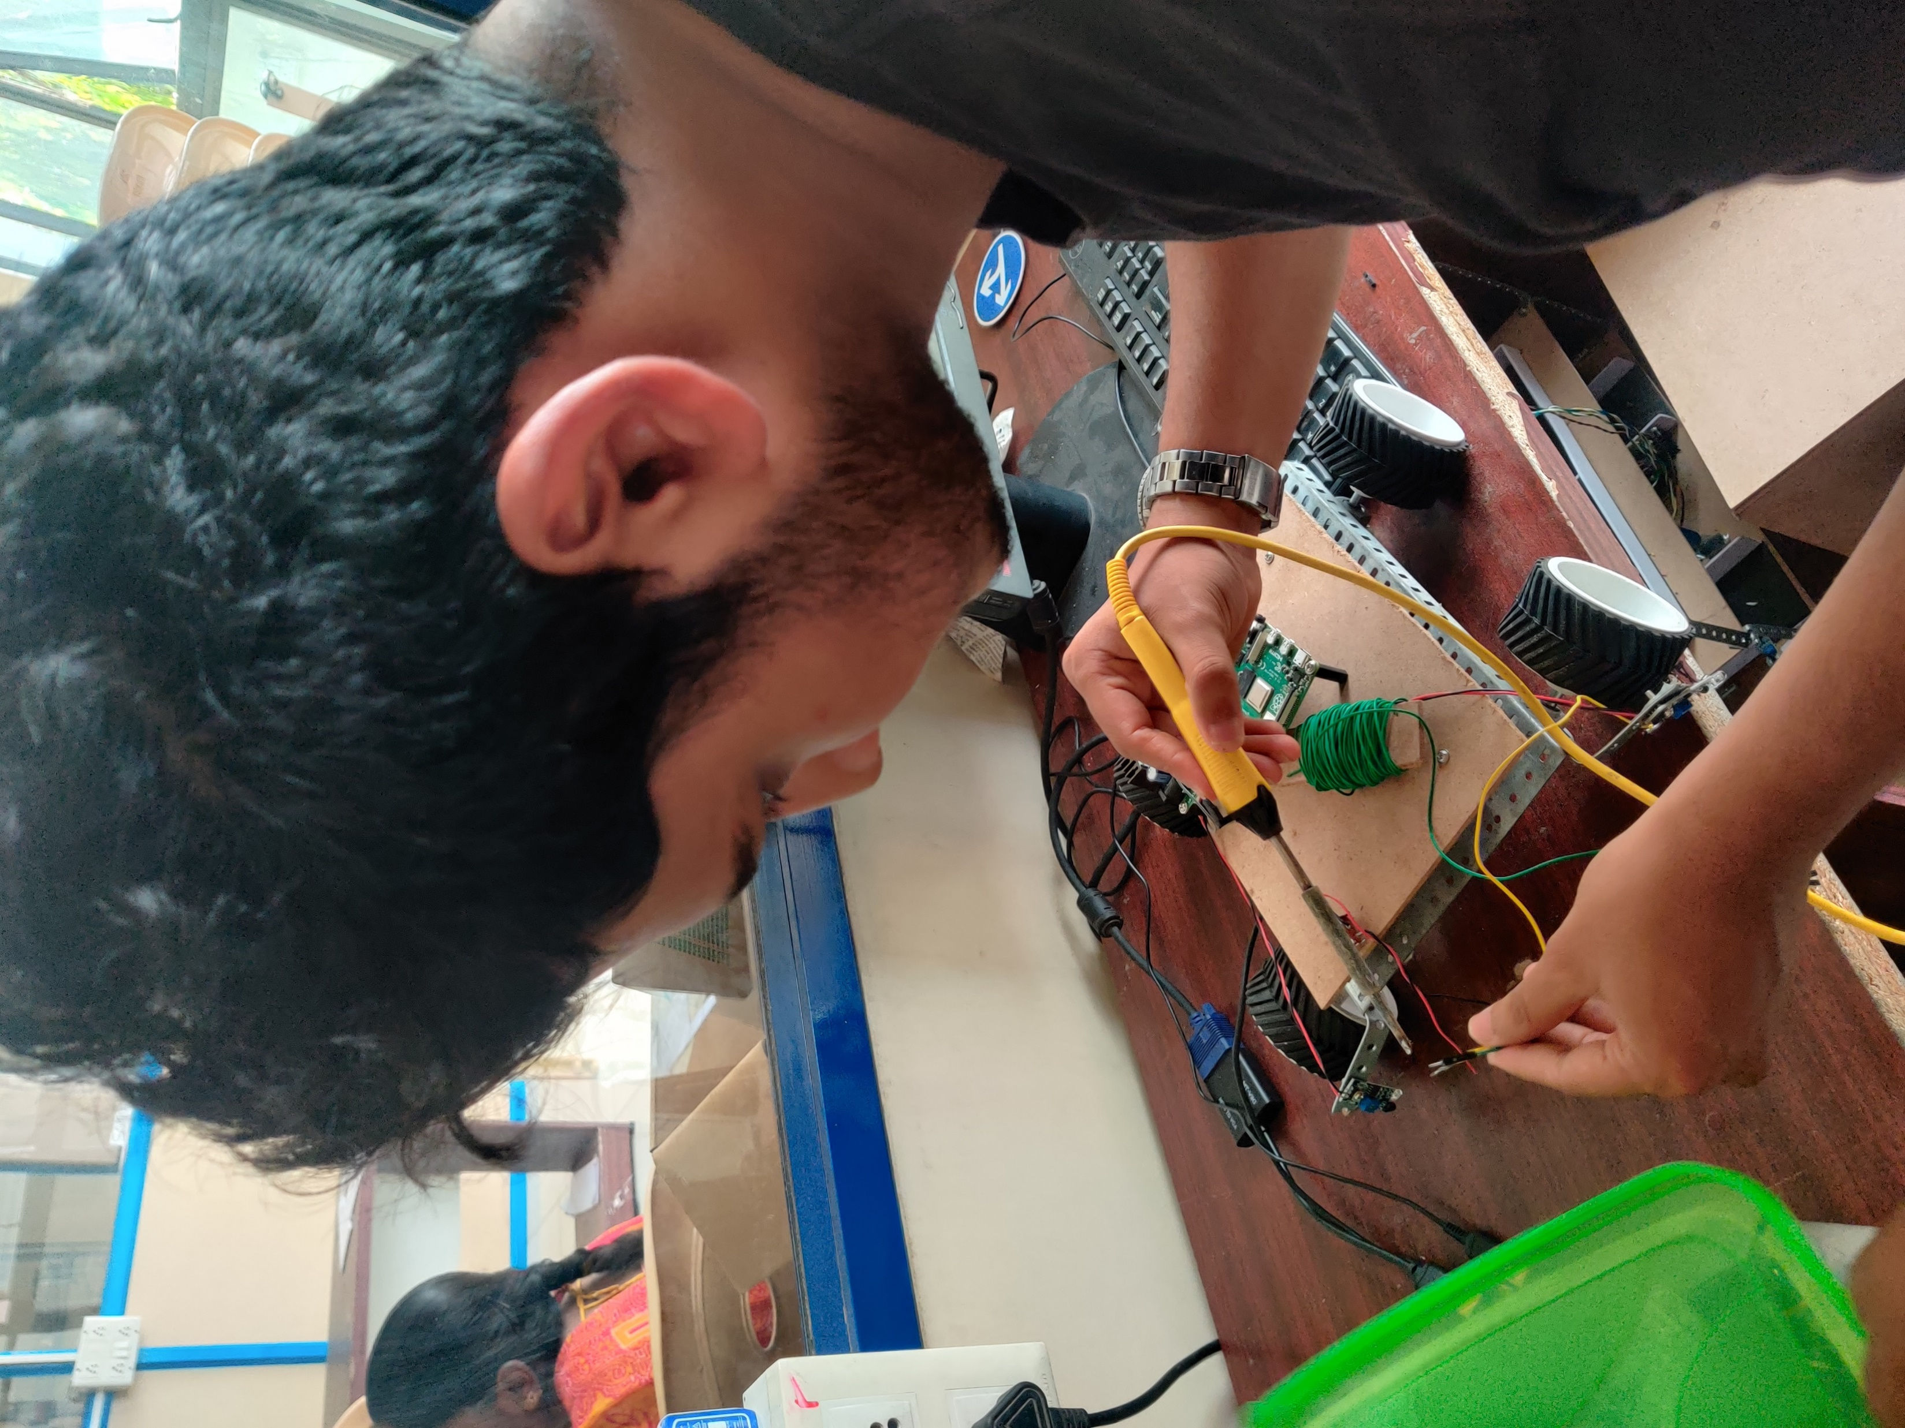
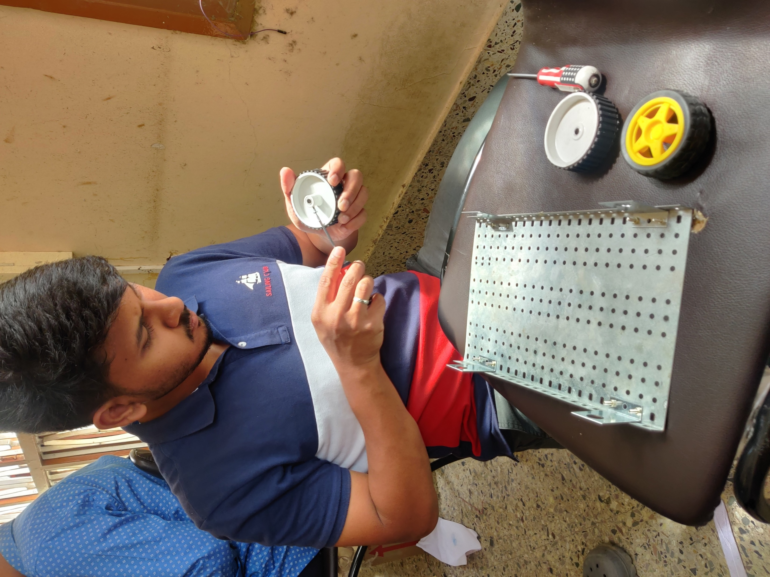
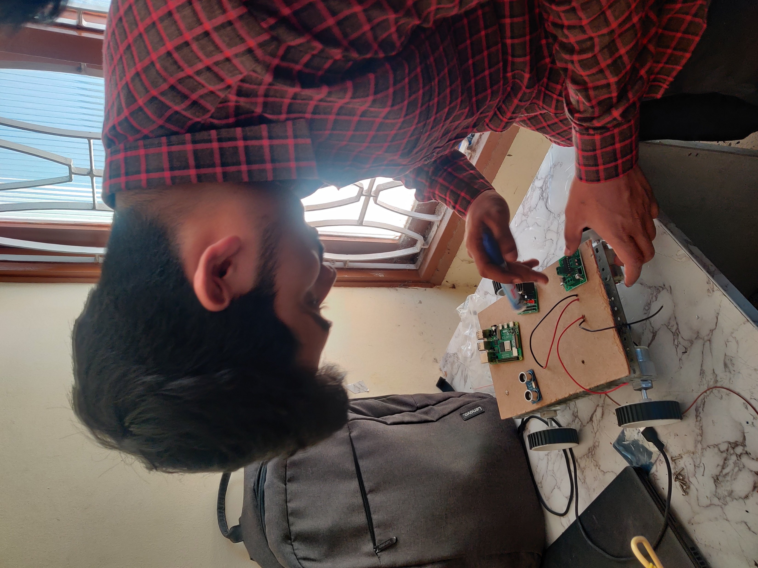
TEAM CONTRIBUTION
Mohammed Sabir
Mohammed Suhail
Mohammed Umarulla
Mohammed Yousuf

Slide 12
REFERENCES
[1] Sanil, Nischal, V. Rakesh, Rishab Mallapur, and Mohammed Riyaz Ahmed. “Deep learning techniques for obstacle detection and avoidance in driverless cars.” In 2020 International Conference on Artificial Intelligence and Signal Processing (AISP), pp. 1-4. IEEE, 2020.
[2] Shaghouri, Anas Al, Rami Alkhatib, and Samir Berjaoui. “Real-time pothole detection using deep learning.” arXiv preprint arXiv:2107.06356 (2021).
[3] Shoeb, Mohammed, Mohammed Akram Ali, Mohammed Shadeel, and Dr Mohammed Abdul Bari. “Self-Driving Car: Using Opencv2 and Machine Learning.” The International journal of analytical and experimental modal analysis (IJAEMA), ISSN 0886-9367.
[4] Usman, Mohammed, Mohammed Riyaz Ahmed, Raveendra Gudodagi, and Nitesh Kumar. “Exploiting the Joint Potential of Instance Segmentation and Semantic Segmentation in Autonomous Driving.” In 2023 International Conference for Advancement in Technology (ICONAT), pp. 1-7. IEEE, 2023.

Slide 13
[5] Aviles, H ´ ector, Marco Negrete, Rub ´ en Machucho, Karelly Rivera, David ´ Trejo, and Hector Vargas. “Probabilistic Logic Markov Decision Pro- ´ cesses for Modeling Driving Behaviors in Self-driving Cars.” In IberoAmerican Conference on Artificial Intelligence, pp. 366-377. Cham: Springer International Publishing, 2022.
[6] Mandal, Vishal, and Yaw Adu-Gyamfi. “Object detection and tracking algorithms for vehicle counting: a comparative analysis.” Journal of big data analytics in transportation 2, no. 3 (2020): 251-261.
[7] Tippannavar, Sanjay S., S. D. Yashwanth, and K. M. Puneeth. “SDR–Self Driving Car Implemented using Reinforcement Learning and Behavioural Cloning.” In 2023 International Conference on Recent Trends in Electronics and Communication (ICRTEC), pp. 1-7. IEEE, 2023.
[8] Muppidi, Shreya. “Image recognition in self-driving cars using CNN.” International Journal of Science and Research Archive 9, no. 2 (2023): 342-348.

Slide 14
[9] Qurashi, Junaid M., Kamal Mansur Jambi, Fathy E. Eassa, Maher Khemakhem, Fawaz Alsolami, and Abdullah Ahmad Basuhail. “Toward Attack Modeling Technique Addressing Resilience in Self-Driving Car.” IEEE Access 11 (2022): 2652-2673.
[10] Ni, Jianjun, Kang Shen, Yinan Chen, Weidong Cao, and Simon X. Yang. “An improved deep network-based scene classification method for selfdriving cars.” IEEE Transactions on Instrumentation and Measurement 71 (2022): 1-14.
[11] Khan, Rameez, Raja Amer Azim, Fahad Mumtaz Malik, Naveed Mazhar, Abid Raza, and Hameed Ullah. “Fixed Settling Time Control for Self-Driving Car: Two-Timescales Approach.” IEEE Access 10 (2022): 36518-36537.
[12] Alhussan, Amel Ali, Doaa Sami Khafaga, El-Sayed M. El-Kenawy, Abdelhameed Ibrahim, Marwa Metwally Eid, and Abdelaziz A. Abdelhamid. “Pothole and plain road classification using adaptive mutation dipper throated optimization and transfer learning for self-driving cars.” IEEE Access 10 (2022): 84188-84211.

Slide 15
[13] Chowdhury, Abdullahi, Gour Karmakar, Joarder Kamruzzaman, Alireza Jolfaei, and Rajkumar Das. “Attacks on self-driving cars and their countermeasures: A survey.” IEEE Access 8 (2020): 207308-207342.
[14] Song, Yuho, Sangwon Han, and Kunsoo Huh. “A Self-Driving Decision Making with Reachable Path Analysis and Interaction-Aware Speed Profiling.” IEEE Access (2023).
[15] Srivastav, Arvind, and Soumyajit Mandal. “Radars for Autonomous Driving: A Review of Deep Learning Methods and Challenges.” arXiv preprint arXiv:2306.09304 (2023

Slide 16
THANK YOU

